Slide 1
Minor
Fit for the Future
Uitvoering I – Soft Systems Thinking
samen doen → samen leren → samen doen → samen leren → samen doen → samen leren → samen doen → samen leren → samen doen → samen leren → samen doen → samen leren → samen doen → samen leren → samen doen → samen leren → …
2 oktober 2019

Slide 2
Facilitator of Change
Een Facilitator of Change begrijpt de verschillende belangen en opvattingen van stakeholders gerelateerd aan wereldwijde en lokale ontwikkelingen, en is in staat om strategische interventies te ontwikkelen voor duurzame transities in de betreffende regio.

Slide 3
Competenties en
Onderzoekende houding
Competenties
  Conceptueel denken
    Systeemdenken, van hard via zacht naar kritisch
  Kritisch reflecteren
    Laws of Form
    Tweedeordeobservaties
  Verbinden
    Relaties
    Ethiek
Onderzoekende houding
  Responsieve methodologie
  Reflexieve monitoring

Slide 4
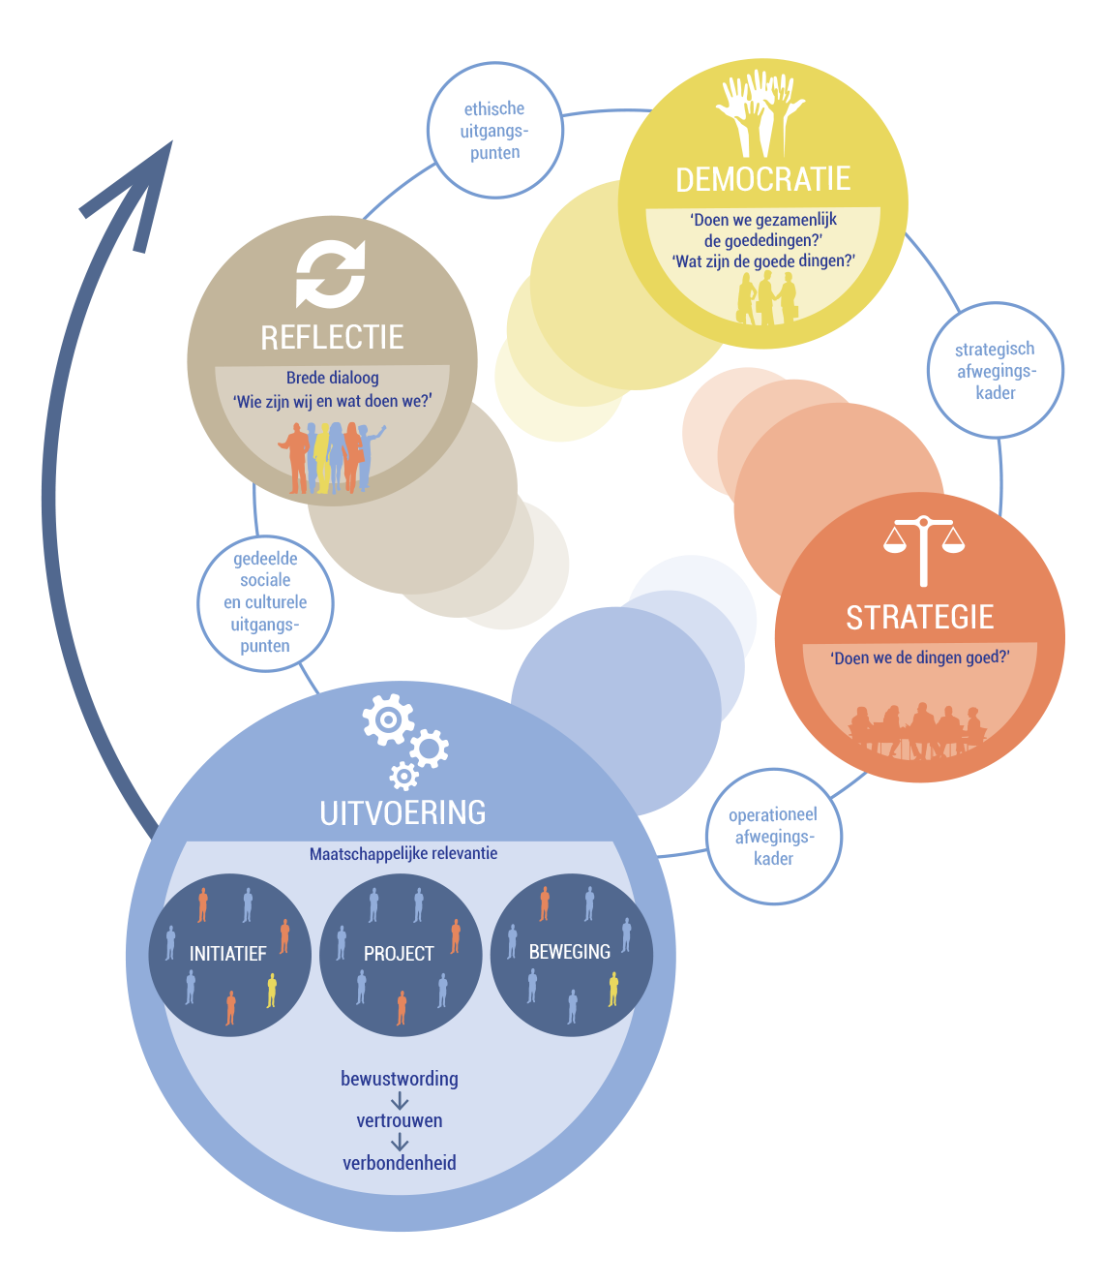
Duurzame, samenlerende maatschappij

Slide 5
Rode draden
  Inhoud-gedreven proces:
    Project staat centraal met de eigen inbreng van de deelnemer in relatie tot anderen: samen doen, samen leren, …;
    Driedubbelslag:
      Voortgang brengen in situatie (arguably desirable, culturally feasible, 3/5 E’s);
      Met nieuwe competenties (conceptueel (systeem-)denken, kritische reflectie, verbinden);
      Met (meta)reflectie, geleerde lessen;
  Sturen op ethische uitgangspunten (wie zijn we, wat doen we?):
    Verificatie → validatie;
    Brede dialoog:
      Draagvlak bij belanghebbenden;
      Druk op democratisch proces;
    Doorvertaling naar afwegingskaders en leidende principes;
  Laws of Form:
    Tweede-orde cybernetica (met rol van observer);
    Autopoiese (zef-productie, Luhmann);
    Tweede-orde observaties, kritische reflectie;
  Ethics of care.

Slide 6
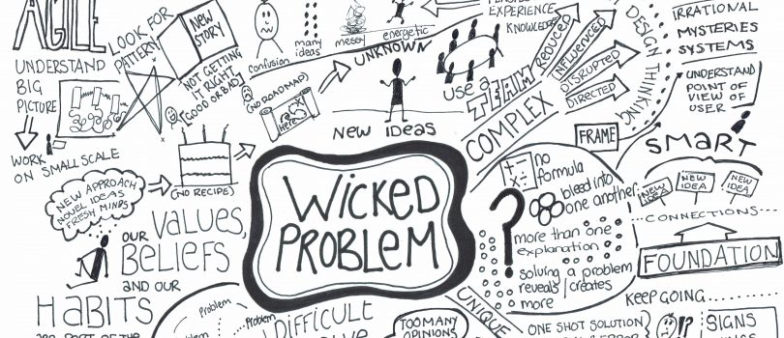

Slide 7
Wicked problem
The problem involves many stakeholders with different values and priorities.
The issue’s roots are complex and tangled.
The problem is difficult to come to grips with and changes with every attempt to address it.
The challenge has no precedent.
There’s nothing to indicate the right answer to the problem.
Nevertheless, in our experiences, it is possible to make progress by using the right methods.

Slide 8
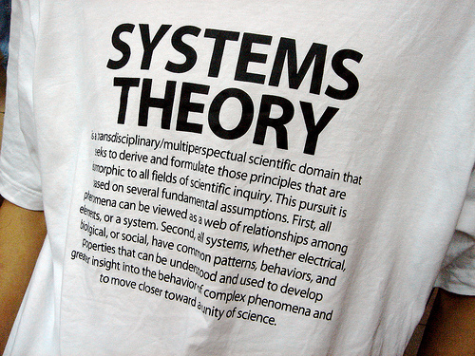

Slide 9
What is a system?
An organized, purposeful structure that consists of interrelated and interdependent elements (components, entities, factors, members, parts etc.). These elements continually influence one another (directly or indirectly) to maintain their activity and the existence of the system, in order to achieve the goal of the system.
All systems have:
inputs, outputs and feedback mechanisms;
maintain an internal steady-state (called homeostasis) despite a changing external environment;
display properties that are different than the whole (called emergent properties) but are not possessed by any of the individual elements;
have boundaries that are usually defined by the system observer.
Source: http://www.businessdictionary.com/definition/system.html

Slide 10
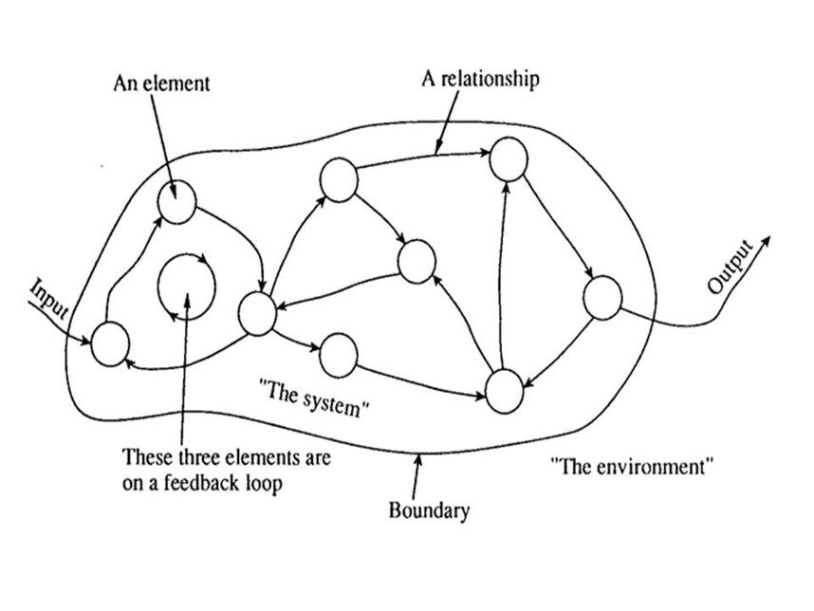
Systems theory
Elements can be anything, e.g., humans, organizations and machines.
New, emergent properties arise from the relations between elements, which cannot be explained by understanding the individual elements.
Taming complexity:
  Sub-systems – subset of elements;
  Aspect-systems – susbset of relationships.
A systems approach begins when first you see the world through the eyes of another.
(C.W. Churchman, 1968)

Slide 11
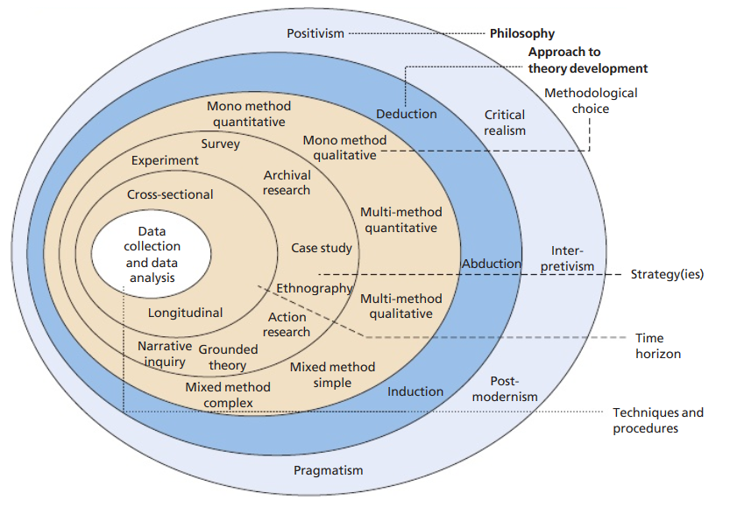
Research onion
(Saunders et al., 2015)

Slide 12
System approaches
Hard
  Production and control (feedback loops, PDCA cycle)
  Common goal
Soft
  Interpreting and accommodating worldviews
  Exploring purpose
Critical
  create change to the benefit of those oppressed

Slide 13
Soft systems thinking
Research philosophy: interpretivism
  Includes the cultural, psychological processes of human activity
Social system is constructed by individuals
  Interpret the viewpoints of individuals rather than taking an outsiders view
Not able to persuade with those in power to participate

Slide 14
Soft Systems Methodology (SSM)
One of the most practiced system approaches:
Soft: unstructured/ill-defined problems;
System: a group of interrelated elements forming a collective entity;
Methodology: the methods and principles used in a particular discipline.

Slide 15
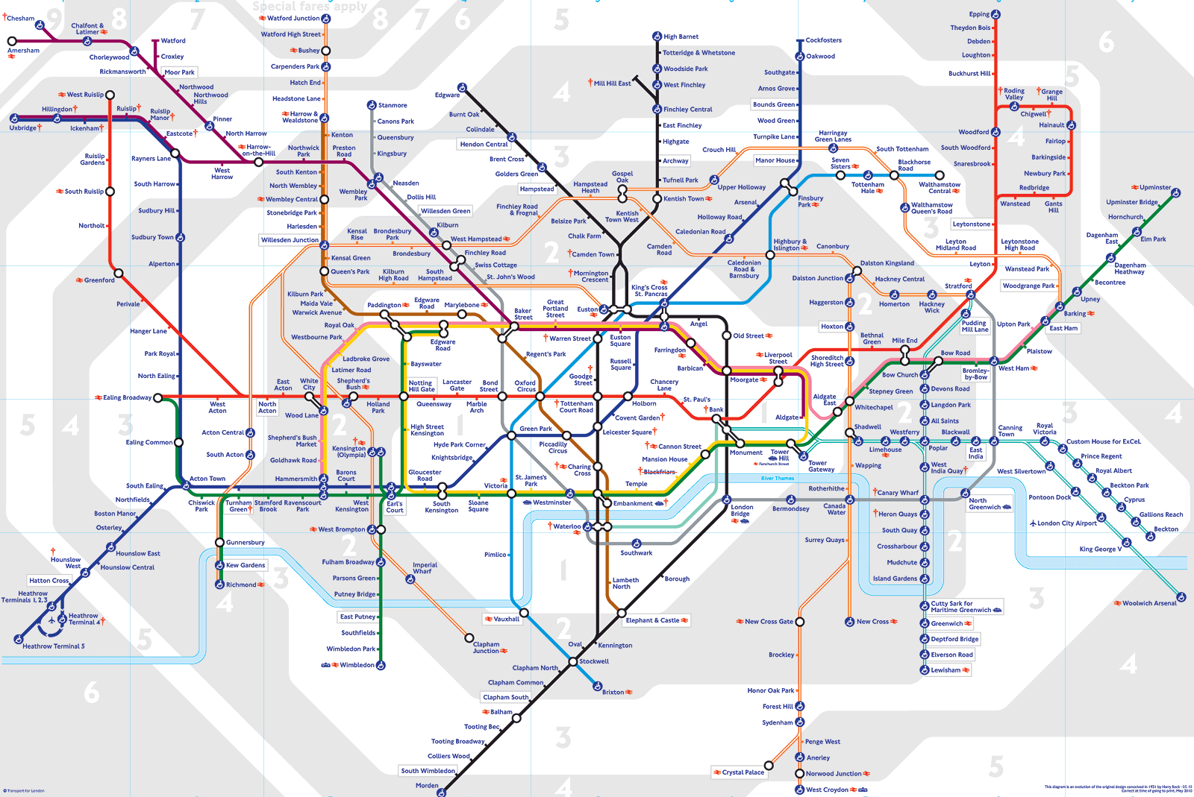
Thinking about how to think
The distinction between the “real world” and “thinking about the real world”
Purpose as emergent property

Slide 16
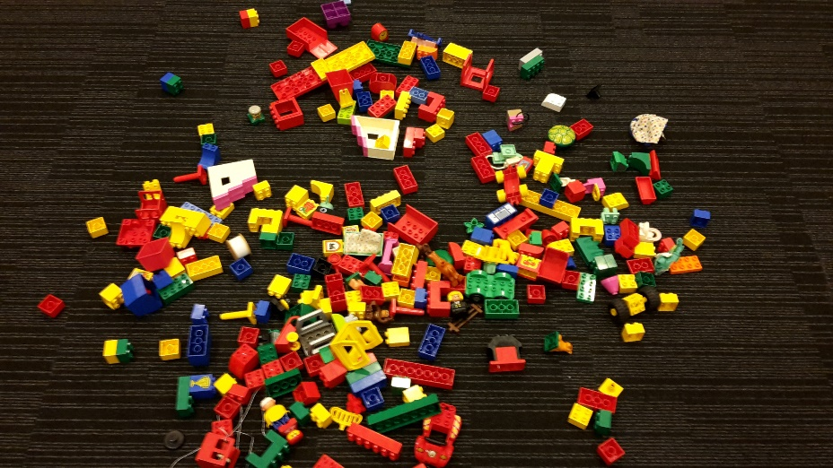
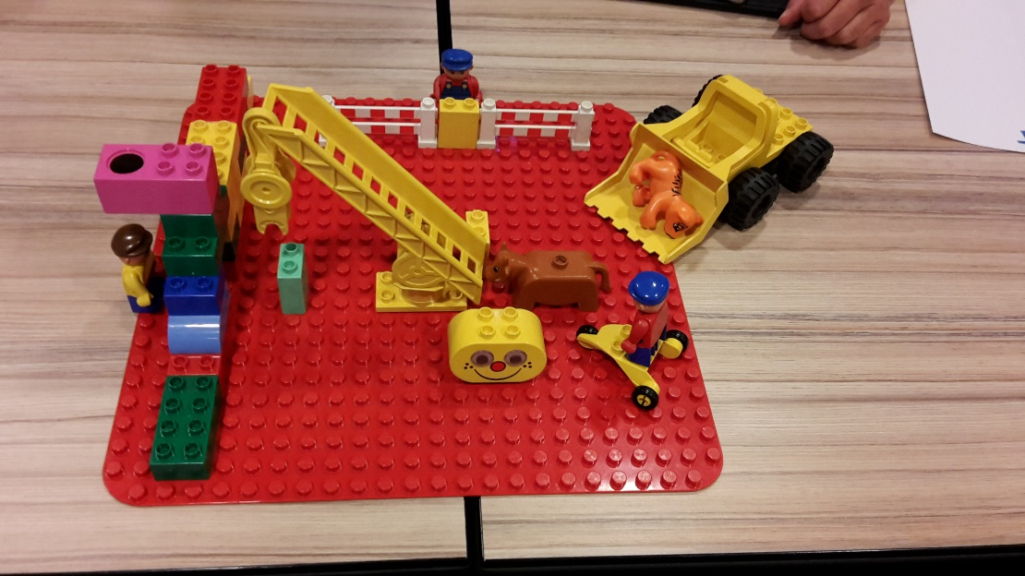
Thinking about how to think
The Real World
Thinking about the Real World
The Real World is:
Complex
Messy
Contains people
Each situation is unique
Don’t try to describe the Real World
Assume:
All individuals are pursuing “Purposeful Activity”
Try to define its Purpose

Slide 17
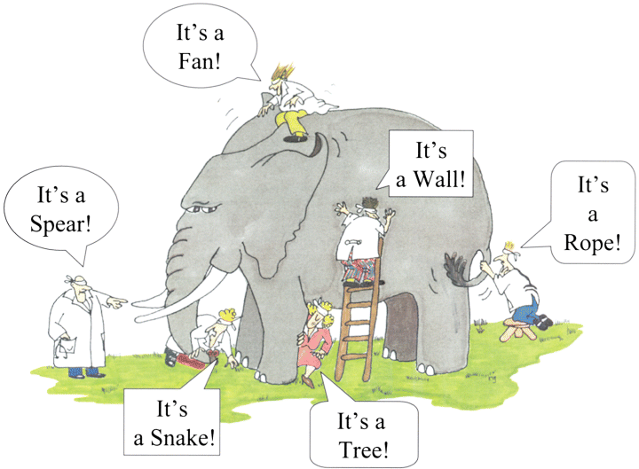
Worldview (Weltanschauung)
Interpretative, multiple perceptions
Persons are usually committed to more than one worldview

Slide 18

SSM process
Four steps to address a problematic situation:
  Finding out (the stakeholders and their concerns)
  Model building (explicating worldviews)
  Discussing and debating (accommadating worldviews)
  Taking action (improving the problematic situation)
In essence, this is a group learning process

Slide 19
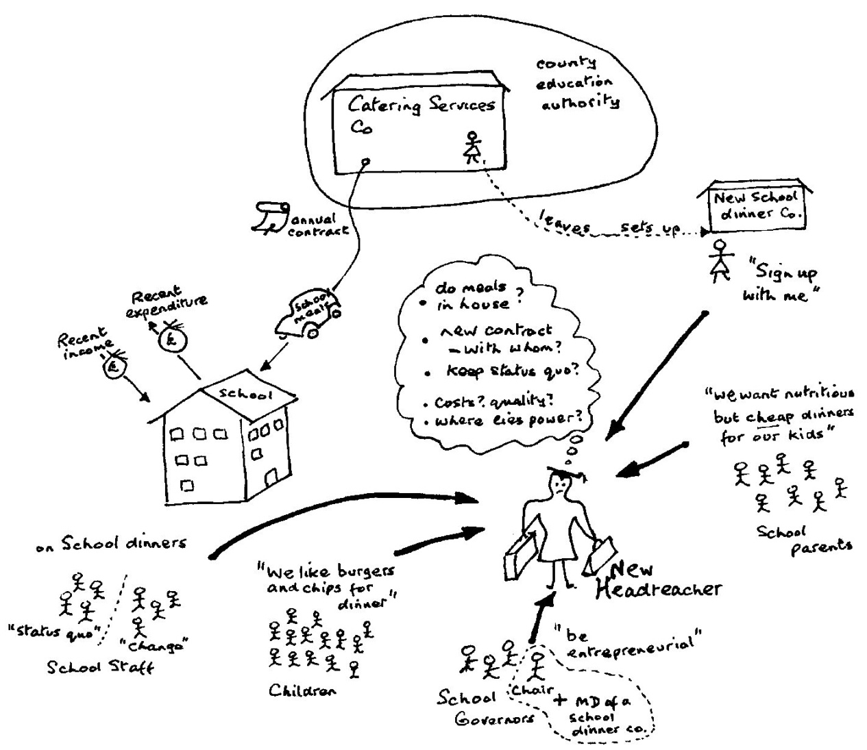
Finding out: making rich pictures
No rules!
Aspects:
  Stakeholders
  Concerns/issues
  Structure
  Process

Slide 20
Exercise
Make a rich picture.
Goal:
  to explain (talk through) the problematic situation;
  To invite stakeholders to enrich or revise the picture.
Form groups, and have a look at: https://www.betterevaluation.org/en/evaluation-options/richpictures
Discuss the rich pictures with members of other groups.

Slide 21
Model building
Human Activity System
(HAS)
A human activity system can be defined as 'notional system (i.e. not existing in any tangible form) where human beings are undertaking some activities that achieve some purpose'
What versus how
What an organization does versus how it does it.
A “what” cannot be implemented except through a particular “how”
“Hows” are observable:
  Result of many decisions over the years at different levels
  Ad-hoc responses to changing conditions

Slide 22
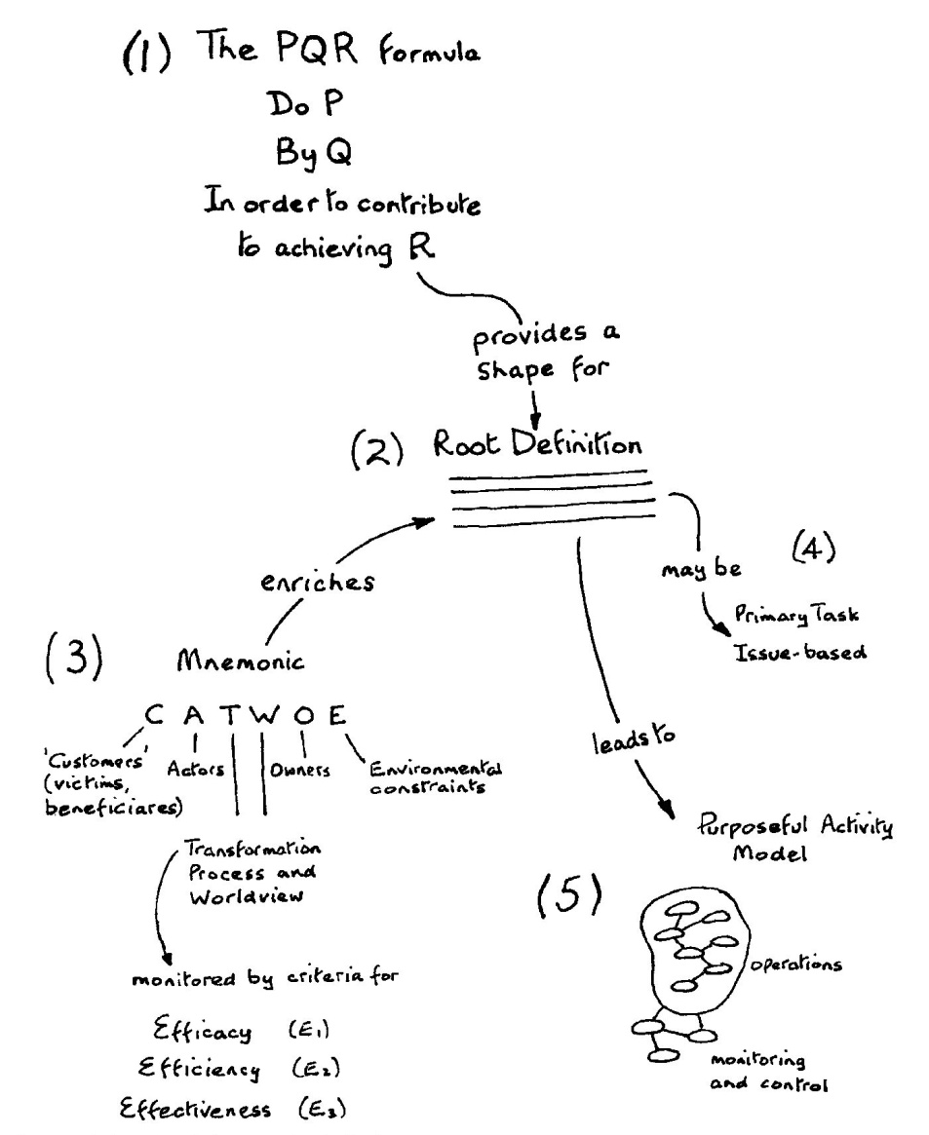
Model building

Slide 23
Root definition
A householder-owned and staffed system to paint the garden fence, by hand-painting, in keeping with the overall decoration scheme of the property in order to enhance the appearance of the property

Slide 24
Exercise
Formulate PQR formulas
Do P by Q in order to contribute to achieving R:
  P – what (activity)
  Q – how (activity)
  R – why (goal)

Slide 25
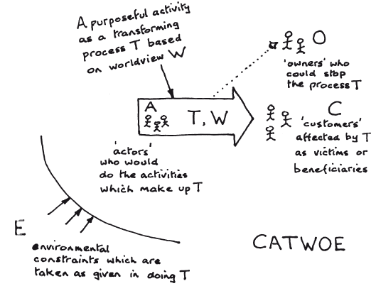
CATWOE
Customers - Who are the beneficiaries of the highest level business process and how does the issue affect them?
Actors - Who is involved in the situation, who will be involved in implementing solutions and what will impact their success?
Transformation Process - What is the transformation that lies at the heart of the system - transforming grapes into wine, transforming unsold goods into sold goods, transforming a societal need into a societal need met?
Weltanschauung - What is the big picture and what are the wider impacts of the issue?
Owner - Who owns the process or situation being investigated and what role will they play in the solution?
Environmental Constraints - What are the constraints and limitations that will impact the solution and its success?

Slide 26
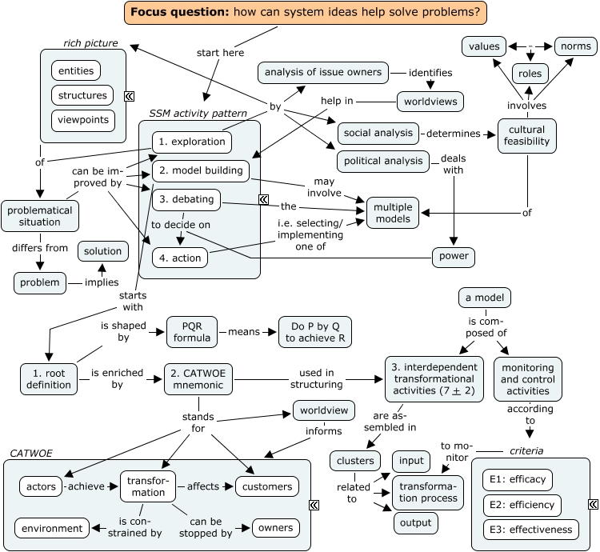
SSM overview

