Slide 1

Crowdfunding

Slide 2
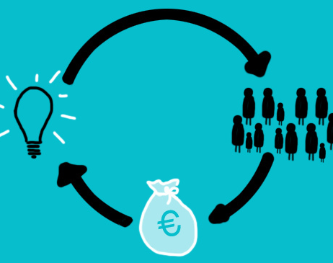
Introduction to Crowdfunding
Crowdfunding is the practice of raising small amounts of money from a large number of individuals to finance a new business venture.
Individuals and businesses use online crowdfunding platforms to invest or raise money for projects.
The crowdfunding platforms make money by charging a fee between 3-12% over the cash raised and offering additional services.
Some platforms offer support on tax relief.

Slide 3
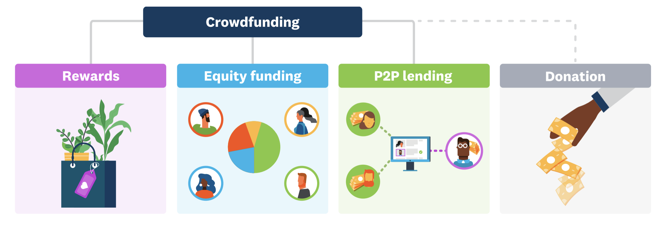
Types of Crowdfunding
Fundraisers presell a product or service to launch a business project without creating debt or sacrificing equity/shares.
The Funder receives shares of a company, usually in its early stages, in exchange for the money pledged.
(FCA regulated in the UK)
Also known as Debt-based crowdfunding where borrowers set up campaigns to fulfil their financial needs, and lenders contribute toward the goal for an interest. (FCA regulated)
Funders donate small amounts of money to the project while receiving no financial or material return.

Slide 4

Tax Relief
UK: Policymakers support crowdfunding via four tax incentive schemes. Two of these schemes are directed to equity investments (EIS and SEIS), one has been designed to lending-based crowdfunding (IFISA), and the last one is addressed to donation-based crowdfunding (Gift Aide Scheme).
Netherlands: Donors can deduct the value of their donations from their taxable income, provided the charity is registered as a public benefits organisation (ANBI). Income tax rates in the Netherlands vary from 19% to 52% and tax-free donations are limited to 10% of the annual taxable income.
Belgium: Tax treatment of crowdfunding loans. Tax exemption on interests produced by loans provided to start-ups through regulated crowdfunding platforms. Belgians can recover annually between 40% and 50% of their donation in charity which may not exceed 10% of their total net income.

Slide 5

Funding Type
All Or Nothing (AON)
Keep It All (KIA)
All Or Nothing (AON), where fundraisers just keep the money when the campaign achieves its set target and the deadline is reached. Once the target is reached, fundraisers can often opt to set a new target and extend the deadline. The money will be deposited into the fundraisers' account once the platform has deducted its fees.
Keep It All (KIA) type allows fundraisers to keep all the money received regardless of achieving its set target or the campaign's duration. Platform and transaction fees are deducted immediately from the money raised to allow quick access to fundraisers.

Slide 6
Top Crowdfunding Platforms in Europe
Platforms | Type | Origin
Crowdcube | Equity-based | UK
Kickstarter | Reward/Donation-based | USA/ *Europe
Seedrs | Equity-based | UK
Indiegogo | Reward-based | USA/*Europe
Anaxago | Equity-based | France
Symbid | Equity-based | Netherlands
Crowdfunder | Reward/Donation-based | UK
Funding Circle | Debt-based | UK
Goteo | Reward/Donation-based | Spain
Spreds | Equity-based | Belgium
Ulule | Reward/Donation-based | France

Slide 7
Crowdfunding Platforms Focusing on Sustainable Projects
Platforms | Type | Origin
Ecco Nova | Equity-based | Belgium
Windcentrale | Equity-based | Netherlands
Oneplanetcrowd | Equity-based | Netherlands
Greencrowd | Debt-based | Netherlands
Triodos Crowdfunding | Debt-based | UK
Energy4impact | Donation-based | UK
Genervest | Debt/Equity-based | Netherlands
ZonnepanelenDelen | Debt-based | Netherlands
Ecocrowd | Reward-based | Germany
Wiseed | Debt/Equity-based | France
Bettervest | Debt-based | Germany
GoParit | Debt-based | Portugal
Green Rocket | Equity-based | Austria/Germany
SeedTribe | Equity-based | UK

Slide 8
Cases focusing on Sustainability within the Tourism and Hospitality Sector on Reward/Donation-based Platforms
Platform | Type | Cases | Money Raised | Number of Funders | Website
Kickstarter | Rewards | The Warden’s House (UK) | £43,147 | 684 | https://www.kickstarter.com/projects/thewardenshouse/the-wardens-house-by-dusty-knuckle-lets-make-it-ha?ref=nav_search&result=project&term=The%20Warden’s%20House
 |  | Native Restaurant (UK) | £50,132 | 198 | https://www.kickstarter.com/projects/1721070072/native-help-us-relocate-our-restaurant?ref=nav_search&result=project&term=Native%20restaurant
Ulule | Rewards | Urban Greener (France) | €12,050 | 253 | https://www.ulule.com/urban-greener/
KissKissBankBank | Rewards | Vrac Gourmand grandit (France) | €4,740 | 55 | https://www.kisskissbankbank.com/en/projects/vrac-gourmand-grandit-vous-grandissez-avec-nous
 | Rewards | Le C'Cube (Belgium) | €3,555 | 71 | https://www.kisskissbankbank.com/en/projects/le-c-cube
Crowdfunder | Rewards Donation Donation | The Platform Café (UK) | £15,552 | 125 | https://www.crowdfunder.co.uk/platform-cafe-recover-rebuild
 |  | Conscious Community Project (UK) | £2,325 | 32 | https://www.crowdfunder.co.uk/consciouscommunity
 |  | The Saltern (UK) | £17,745 | 226 | https://www.crowdfunder.co.uk/help-finish-the-saltern
Indiegogo | Rewards | Wheelys Green Warrior 1 (Sweden) | £566,268 | 333 | https://www.indiegogo.com/projects/world-s-greenest-cafe-the-wheelys-green-warrior-1/x/27021395#/
Growfunding | Rewards | Café Boudin (Belgium) | €21.124 | 160 | https://www.growfunding.be/en/projects/cafeboudin
 | Rewards | Boentje café (Belgium) | €14.235 | 199 | https://www.growfunding.be/en/projects/boentjecafe

Slide 9
Cases focusing on Sustainability within the Tourism and Hospitality Sector on Equity-based Platforms
Platform | Type | Cases | Money Raised | Number of Funders | Tax Relief | Website
Crowdcube | Equity 16.46% | Hen Restaurants (UK) | £147,830 | 139 | SEIS | https://www.crowdcube.com/investment/hen-restaurants-20621
 | Equity 9.98% | Daisy Green Collection (UK) | £1,994,700 | 725 | EIS | https://www.crowdcube.com/companies/daisy-green-collection/pitches/byOoJl
Seedrs | Equity 18.85% | The Brook (UK) | £170,481 | 293 | EIS | https://www.seedrs.com/the-brook
 | Equity 4.76% | Pale Green Dot (UK) | £439,576 | 193 | N/A | https://www.seedrs.com/palegreendot
Crowd2fund | Equity 5% | Silo Brighton (UK) | £48,000 | 12 | SEIS | https://www.crowd2fund.com/campaign/silo-brighton-limited/zero-waste-restaurant-celebrating-pure-foods-1

Slide 10
Cases focusing on Sustainability within the Tourism and Hospitality Sector on Debt-based Platforms
Platform | Type | Cases | Money Raised | Number of Funders | Website
Triodos crowdfunding | Debt 5% interest | The Better Food Company (UK) | £800,000 | N/A | https://betterfood.co.uk/
Oneplanetcrowd | Debt 6 % Interest | Biological Restaurant BioToko (Netherlands) | €101.640 | 133 | https://www.oneplanetcrowd.com/en/project/138460/description
 |  | Uco Werken in het duurzame hart (Netherlands) | €250.000 | 86 | https://www.oneplanetcrowd.com/en/project/200415/description

Slide 11
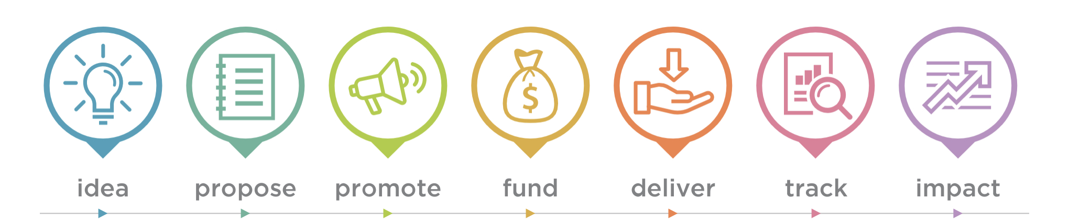
Steps for Crowdfunding
Different Models of Crowdfunding will require different approaches. For example, for the Equity and Debt-based types, the fundraiser will need to do extra work by gathering all the relevant data of their business to ensure that all the facts are reliable and consistent. On the other hand, platforms have less checking and scanning with the Rewards and Donation-based models, which put most of the responsibility on the funder to find out more about the business and fundraiser.

Slide 12
Pre-Campaign Steps
Choose the crowdfunding model and the platform.
Does the fundraiser have a strong community following the business that will take part in the raise?
Are the fundraiser able to secure an anchor investor before the raise going live on the platform?
Do the fundraiser have a clear value proposition that will resonate with potential investors and enable them to see the growth potential that the business offers?
Set a realistic target on how much to raise.
Get the company’s valuation (What the business is worth) (some platforms will challenge unreasonable valuations) (business must bear in mind that the lower valuation, the more potential an investor will see in the business)
How much Equity it should pass on to investors (Equity-based)
Provide evidence to back up any statements made in the pitch. (Equity and Debt-based platforms would need to verify any claims about the company’s financial performance).

Slide 13
Steps for After Platform Approval
Prepare the pitch to be presented to investors on the platform. (Many platforms offers support for preparing the pitch).
Tell the company’s story in the pitch that contains information about: the company’s achievements to date/How the company plans to grow/A sense of who the fundraiser is as a company/An intro to the team/Why the fundraiser started the business/Why the fundraiser thinks the company will be successful. (Many platforms will ask for evidence to each claim).
Gather all relevant evidence for each part of the campaign.
Produce a video and images that bring the pitch to life. (Showing the excitement and prospect of the business).
Marketing the campaign. (Fundraisers need to start publicising the campaign before it goes live). (Activate the network and maximise awareness of the business amongst the target investor base consistently from pre-launch until the close of your campaign).
As campaigns can run from 30 for up to 60 days, it is important to be fully prepared. (Fundraiser should try and spend two to four weeks planning out the marketing needed to support the raise and the cash flow they will need for that).
Before going live to the general public with the raise, begin drumming up interest from the fundraiser’s existing contacts and potential investors. (Some platforms will help run a pre-registration campaign to gather the contacts of potential investors)

Slide 14

Step-by-step to create a campaign on Kickstarter
The Process to Start a Campaign on Kickstarter. As an example, we will create a project for a Café called Green Cafe to become more sustainable by installing solar panels to create and use clean energy and using locally sourced produces to decrease carbon footprint and help the local economy. Then we will set a target to raise £10,000 in 30 days in exchange for rewards to its funders as coffee and cake vouchers.

Slide 15
Step-by-step to create a campaign on
Register yourself on the Kickstarter website. They ask for name, email, and to create a password and click start a project.
You need to select a project category to connect to the specific community. This part can be updated later. For our example, you must choose the Food category.
Project Idea: Here, you will describe the project and how you will become more sustainable.
Confirmation of eligibility. Here you must select your country from their list. Currently, Kickstarter have 25 countries on their list, including the UK, the Netherlands and Belgium. Choose UK, then you have to verify your age as you must be over 18. And verify that your address and bank account are in the UK. Also, verify a government-issued ID such as Passport. Finally, you will need a debit and/or credit card.
A preview page of your project will be shown that only you or the people you share with can see. You can start to create and edit your campaign.
Continue

Slide 16
Step-by-step to create a campaign on
There are 5 steps to create the project before submitting it to project review, where Kickstarter will allow it to go live.
Basic: On the Basic page, you will add information to learn about the project, for example, Title, Subtitle, Category and subcategory and Location. You must upload an image for the project. Videos are optional on Kickstarter, but they recommend adding one as 80% of successful cases had a video. Then you should set a funding goal; in our case, it will be £10,000. Next, you choose the campaign duration between 1-60 days.
Rewards: The average number is 3-10 rewards that can be physical items or special experiences. On this page, you should add the rewards by providing information about it, such as title, price and description. An example for our case would be 'Coffee+Cake' Rewards for every £10 funded.
Story: Introduce your project, describing what you are raising funds for, why you care about it, how you plan to make it happen and who you are, or what the business stands for. Here you can add your profile and introduce the team.
Payment: Here, you should confirm your identity and link a bank account. Also, provide additional details about yourself and where funds should be sent if your project is successfully funded.
Promotion: Prepare for launch by getting ready to promote your project. Project URL, the platform will use your current project title to generate a URL. Potential backers will find it on Kickstarter, but you should share your pre-launch page with everyone to create excitement and attention around your project before you launch it. Google Analytics gives insight into your project's performance, including the number of visitors to your page and how many of them convert into pledges. At this stage, you will need to keep updating the campaign's progress and keep sharing it on social media to create momentum and attract more funders.
Once the campaign is over and the target reaches the All or Nothing system, Kickstarter will deduct 5% of the total amount raised + transaction fees before transferring the money to your account.
Continue

Slide 17
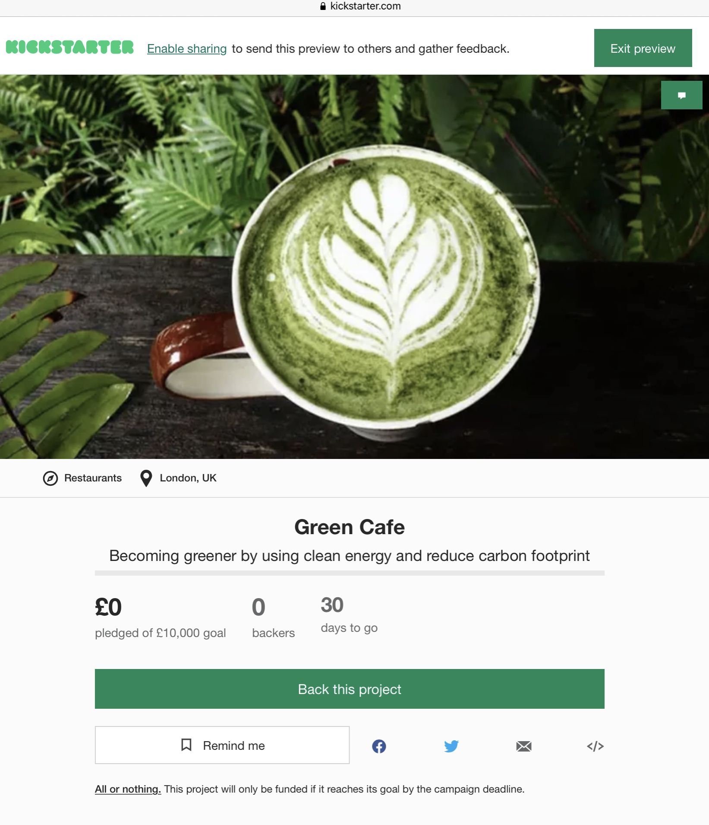
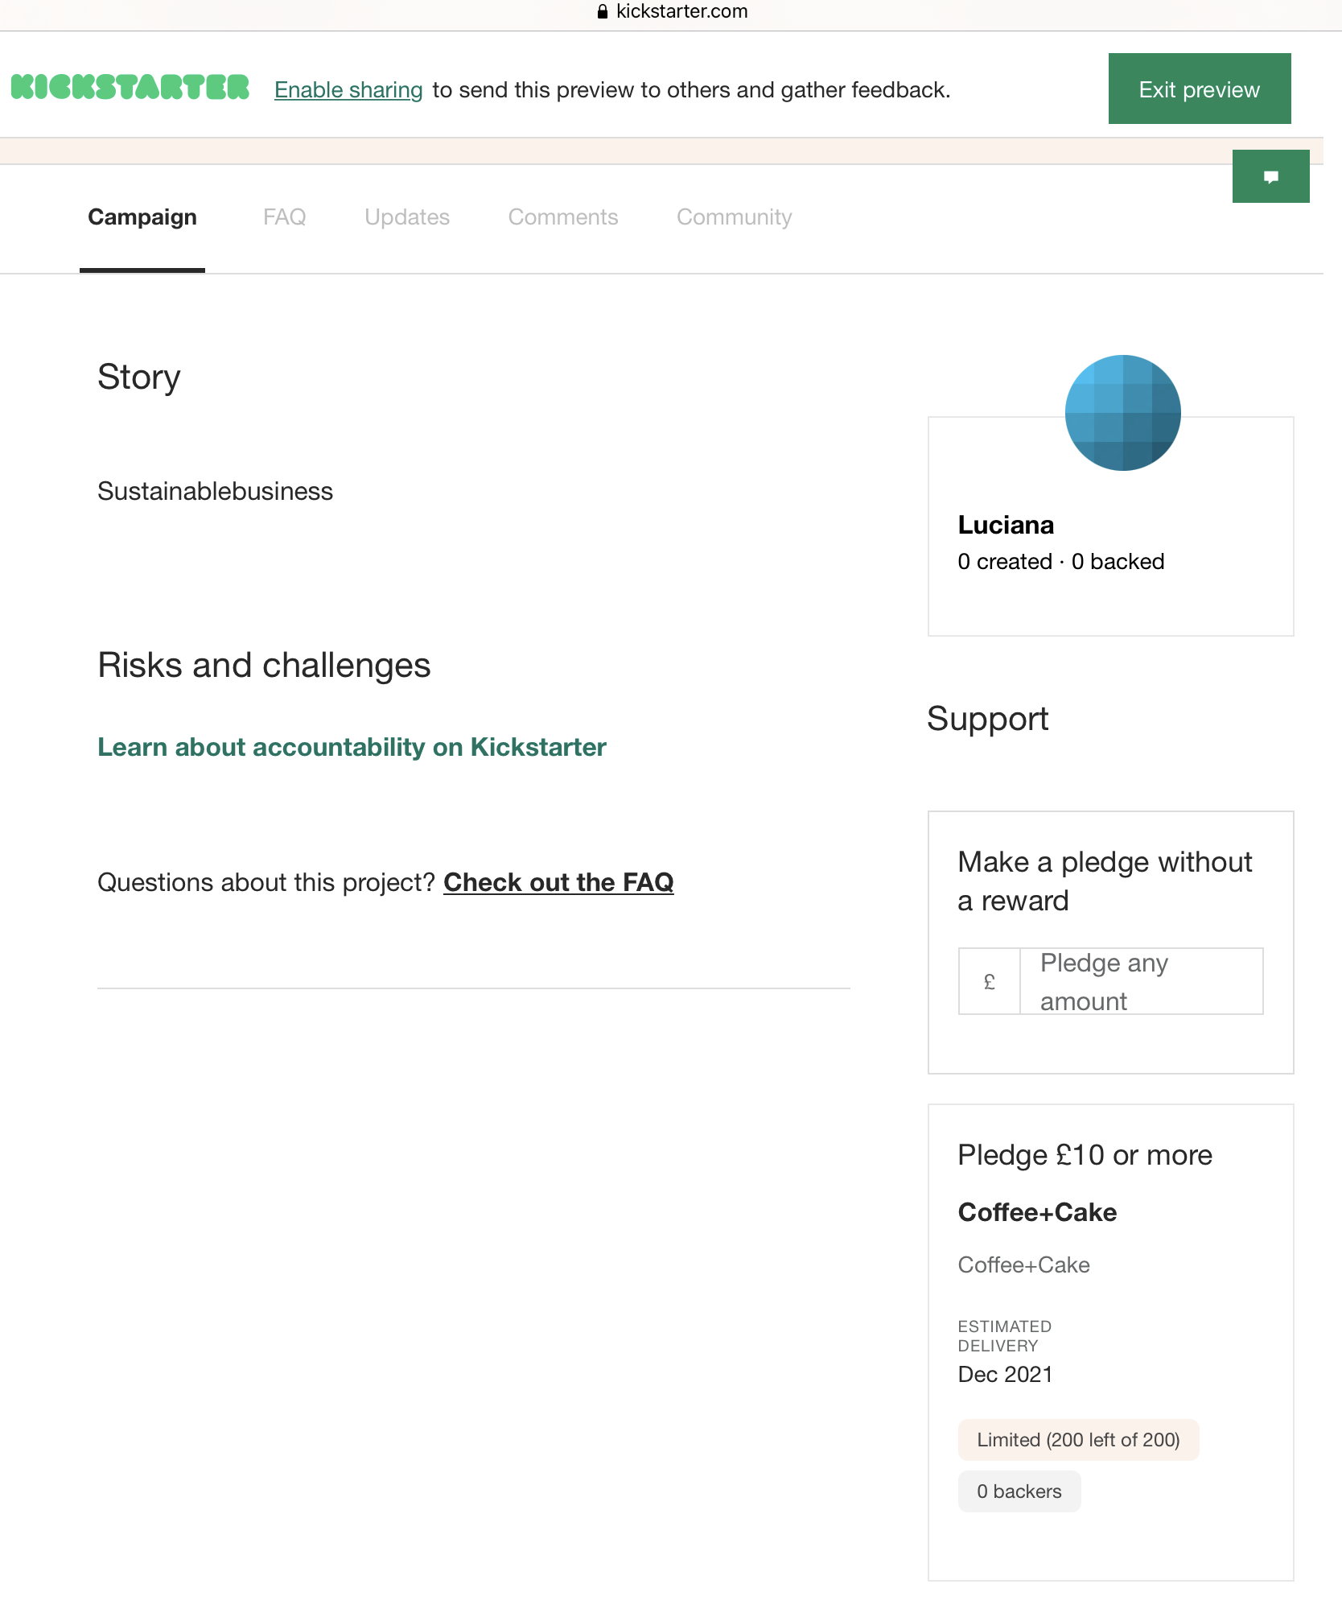
Final Results on Creating the Example Campaign on

Slide 18
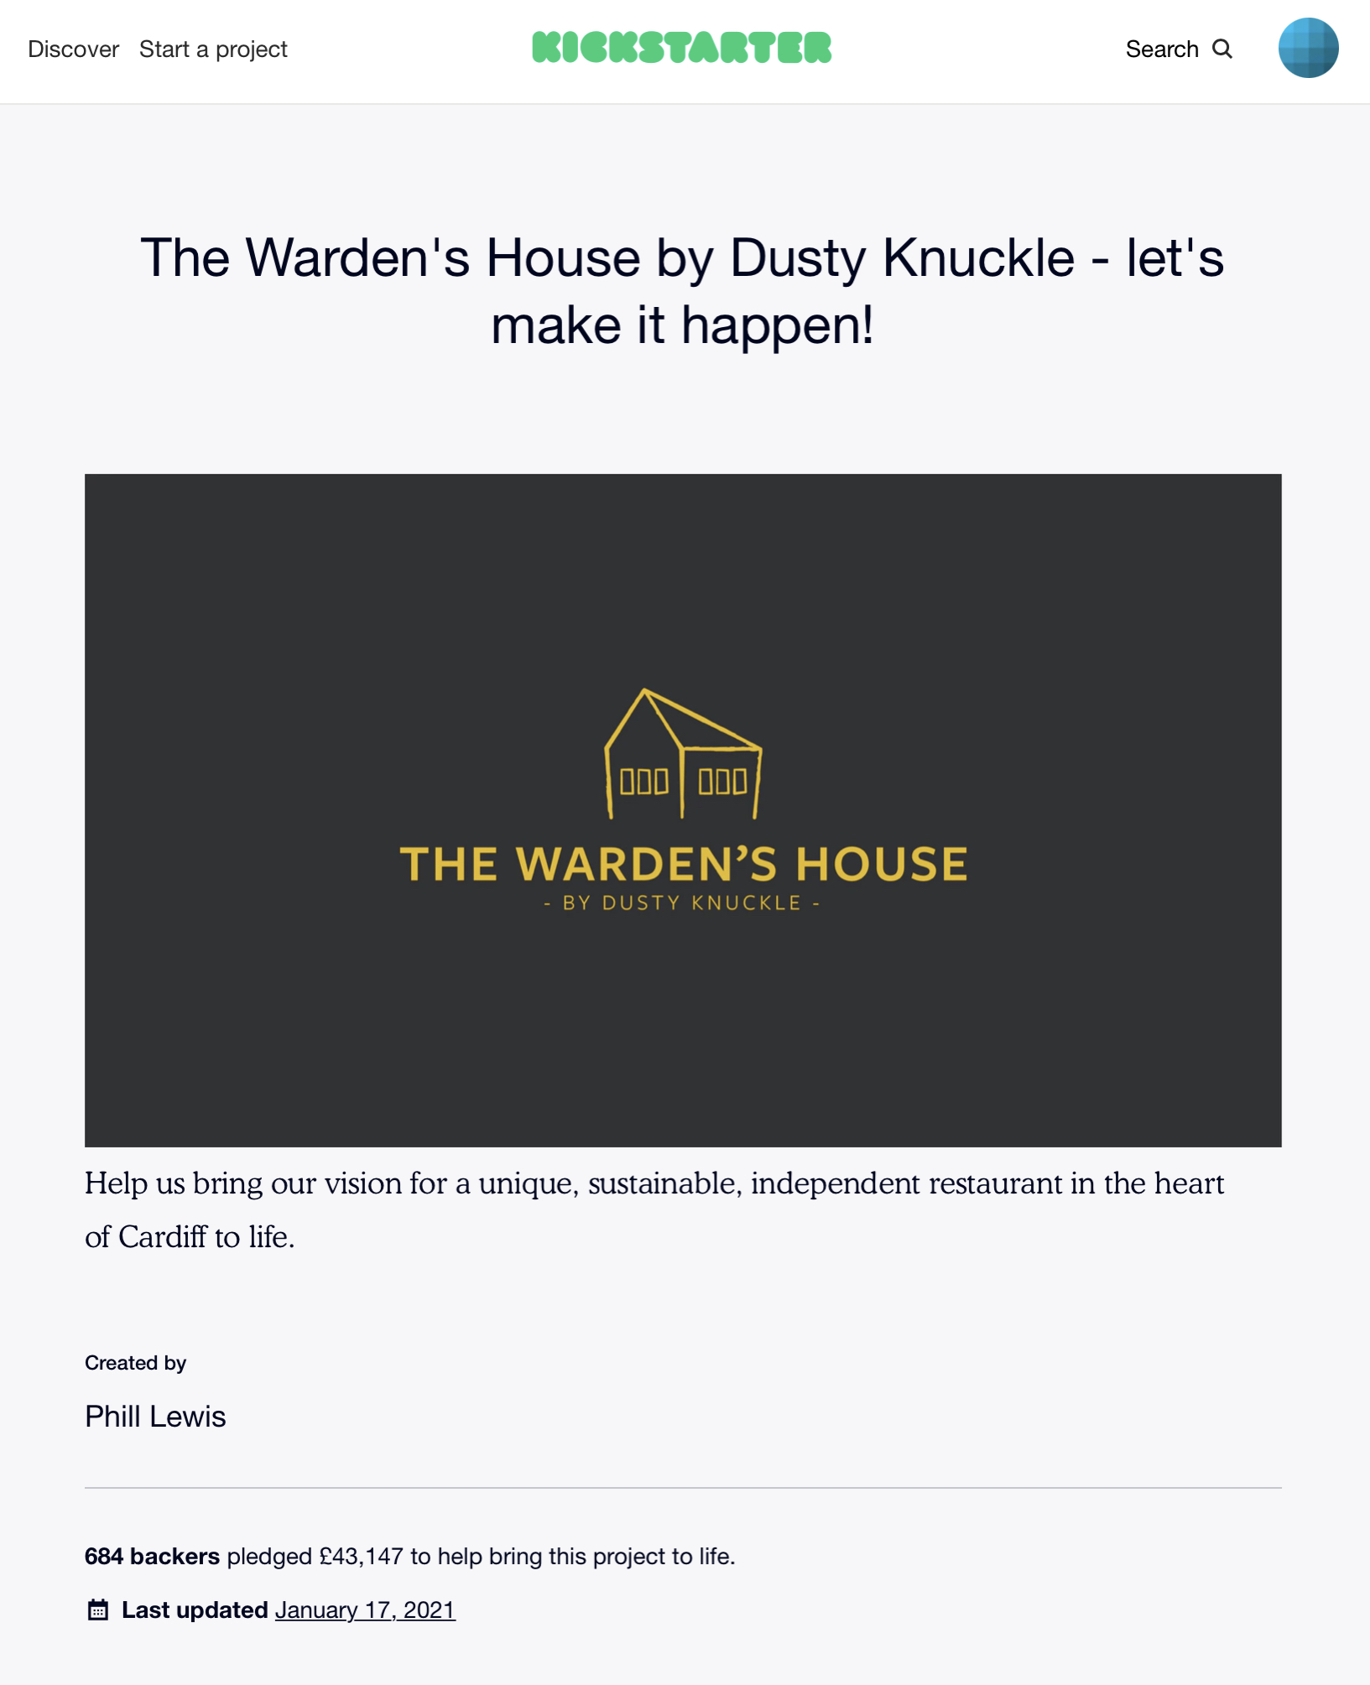
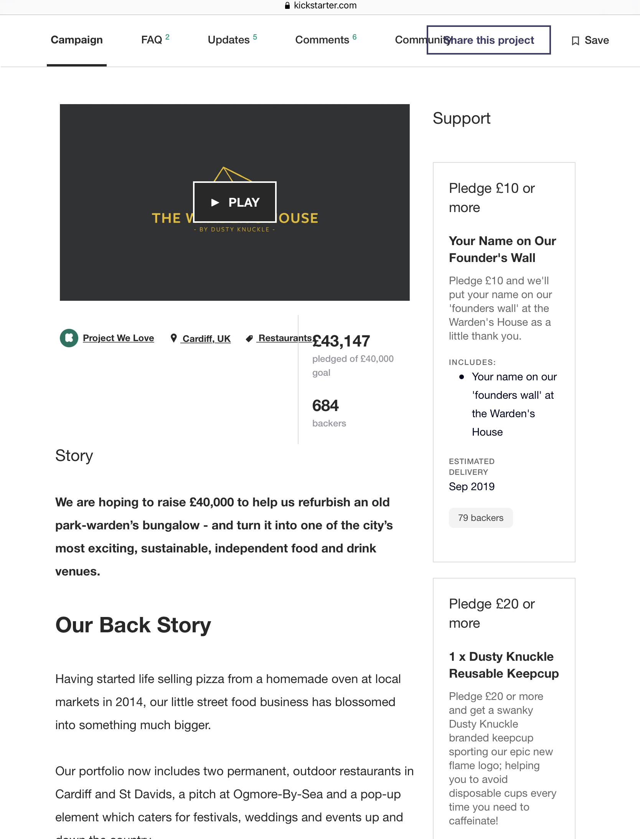
Case 1 (UK): The Warden’s House by Dusty Knuckle on
This restaurant based in Cardiff created a successful campaign by raising £43,147 to refurbish an old bungalow to create a sustainable restaurant.

Slide 19
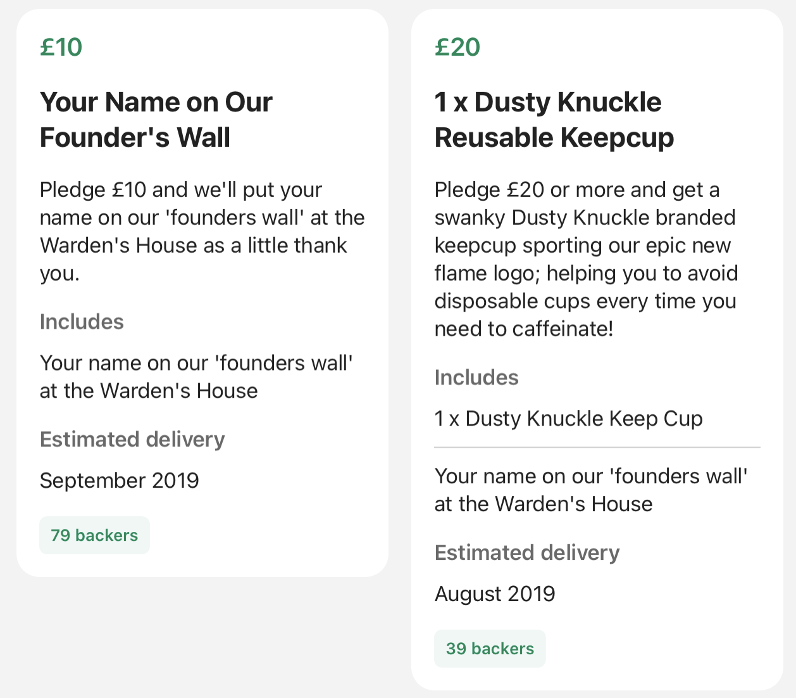
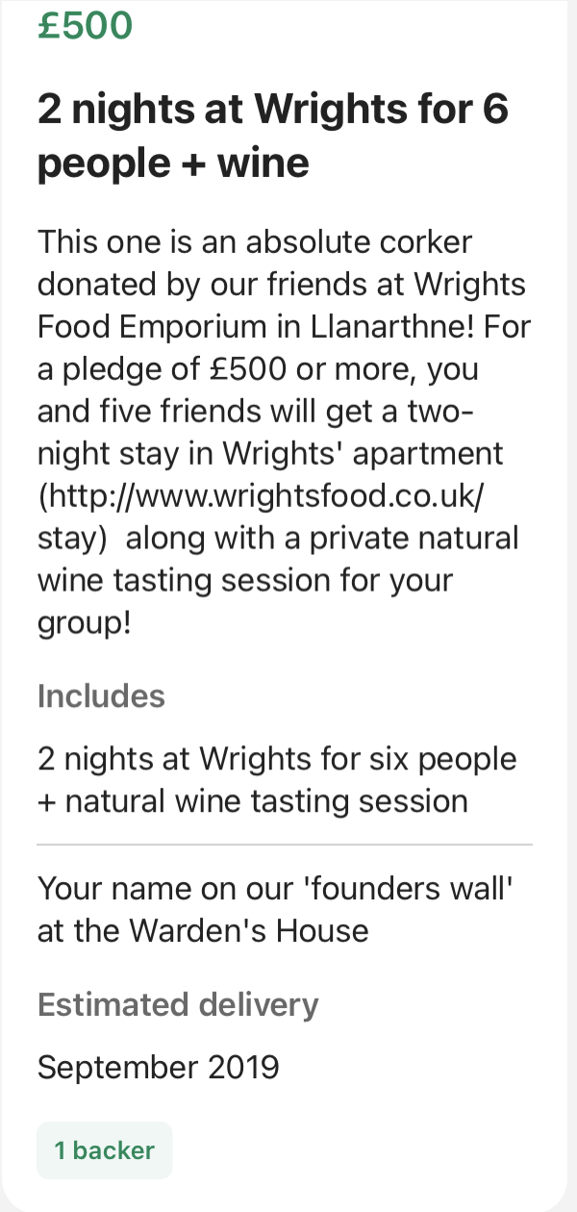
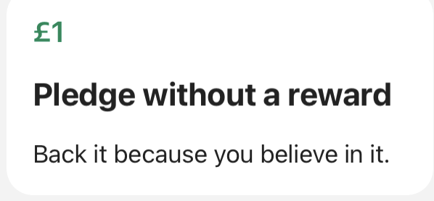
Multiple Rewards
The Warden’s House offered 57 Multiple Rewards starting from a donation of £1 without rewards to £500 for a 2-night stay for 6 people.

Slide 20

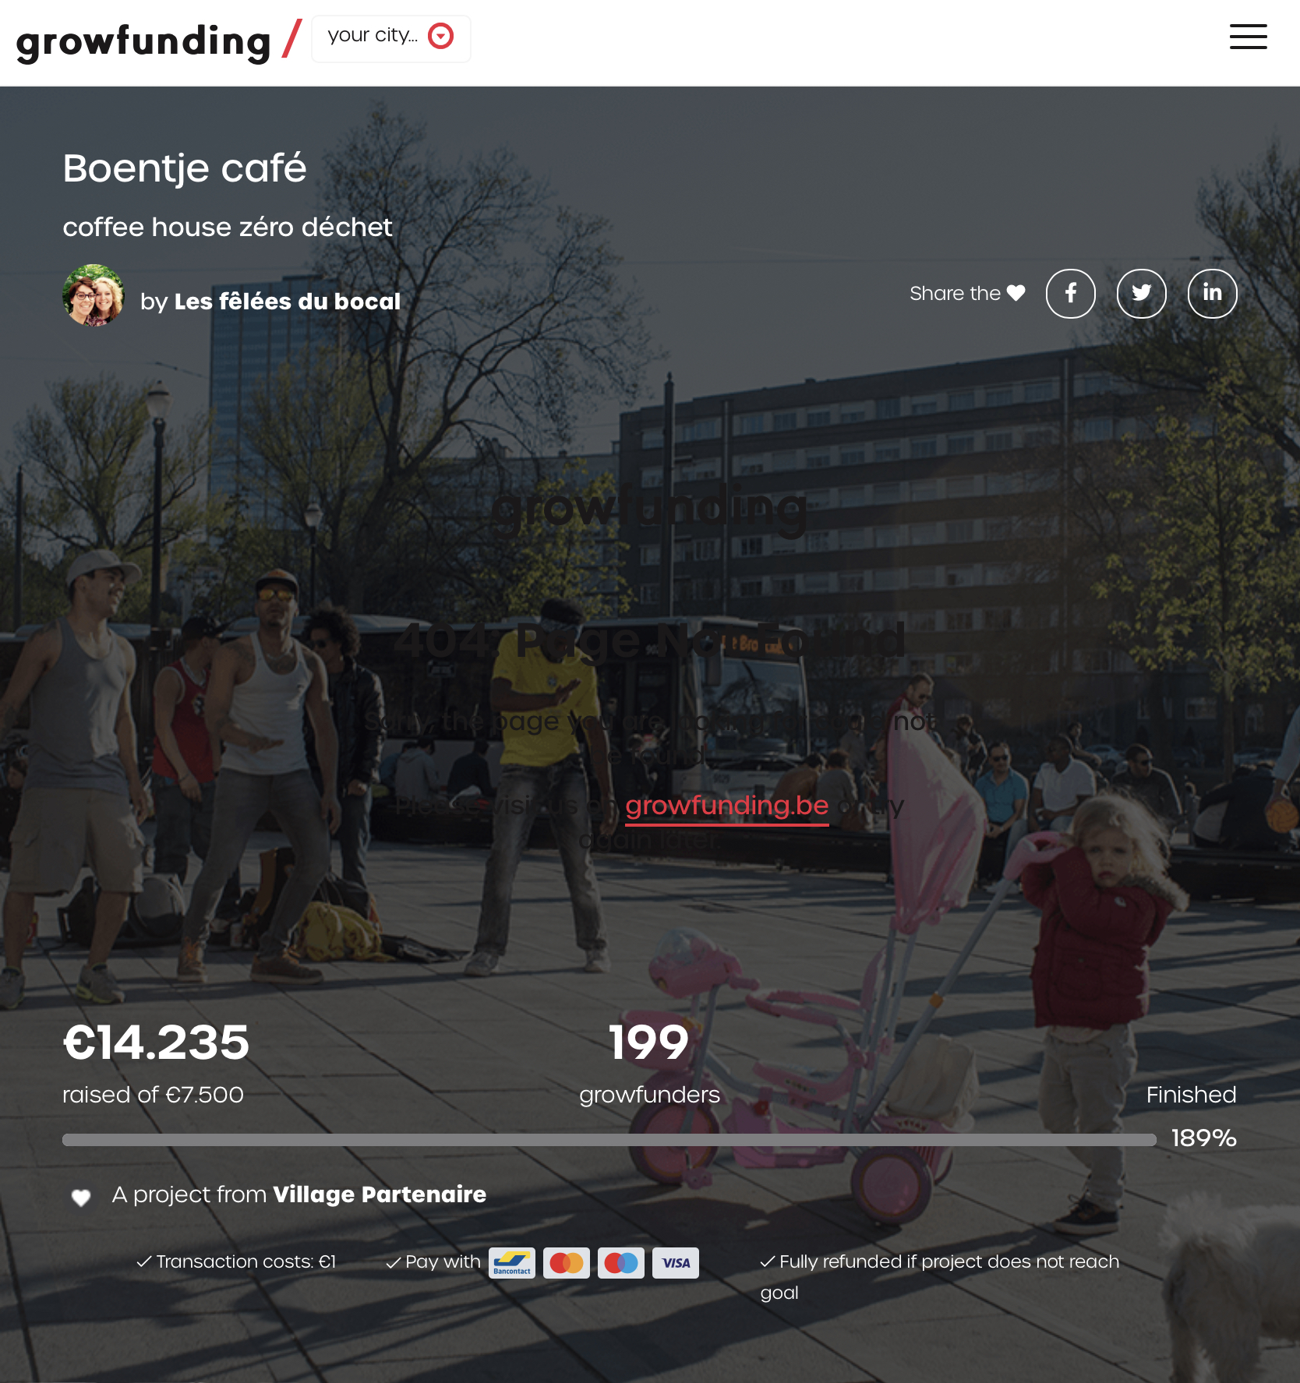
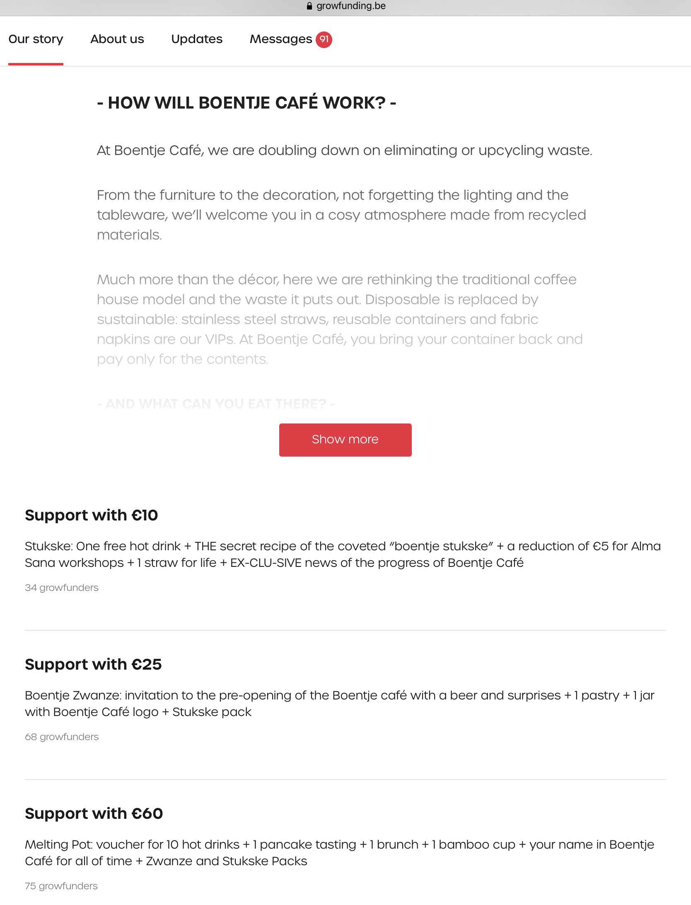
Case 2 (Belgium): Boentje Café, a Zero Waste Coffee House on
The Boentje Café created a successful campaign where it raised €14,235 to improve its facilities to become more sustainable.

Slide 21
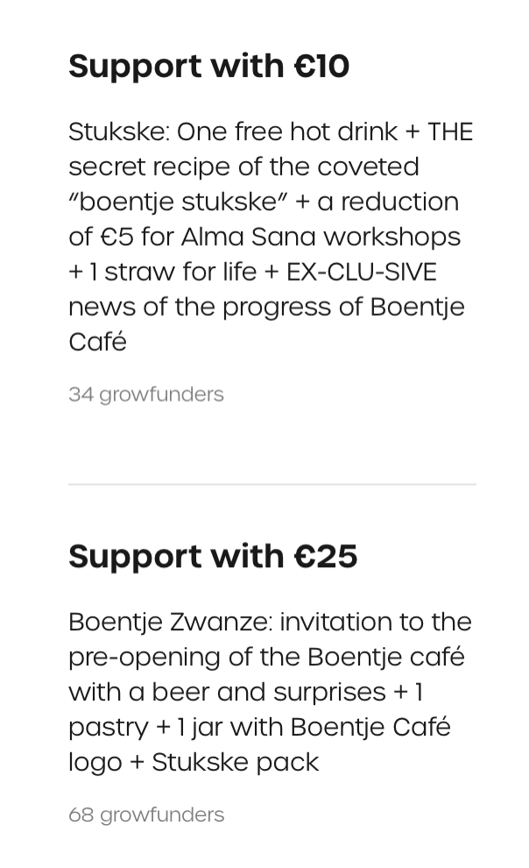
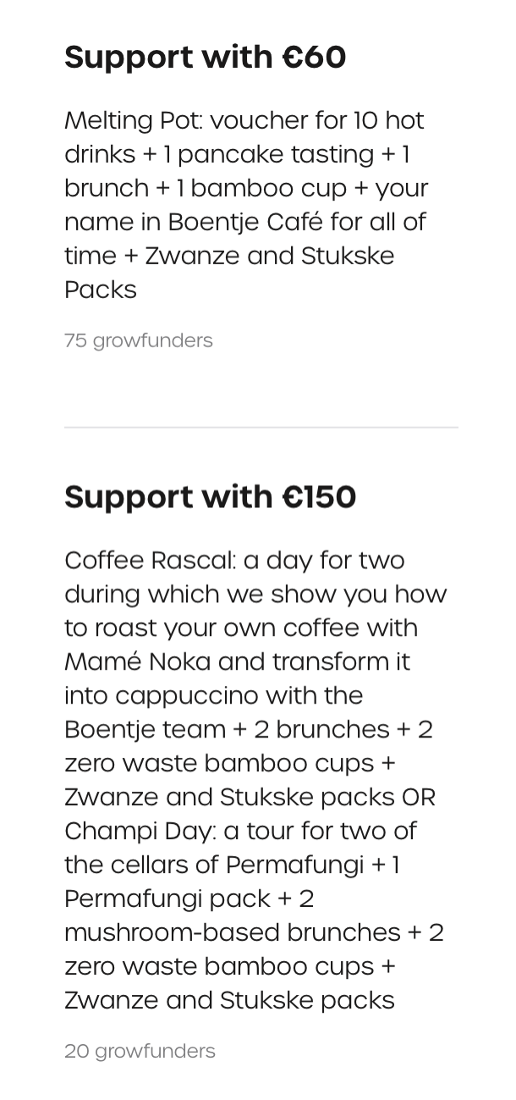
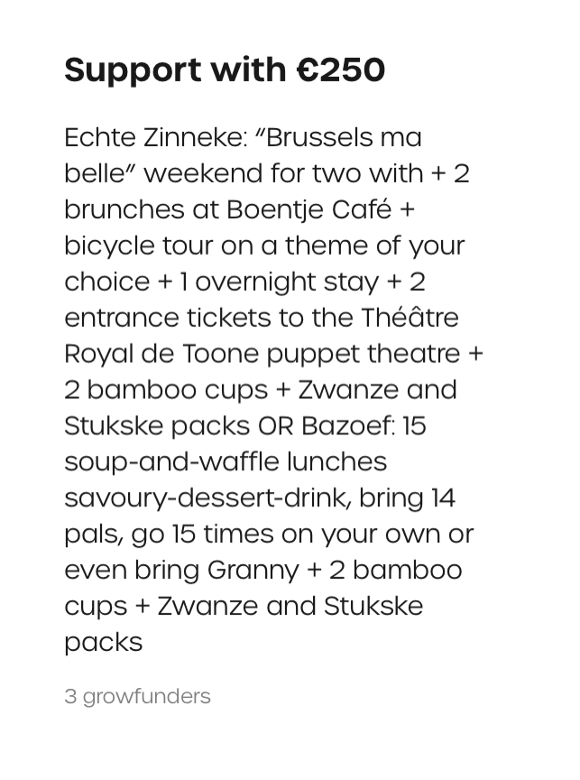
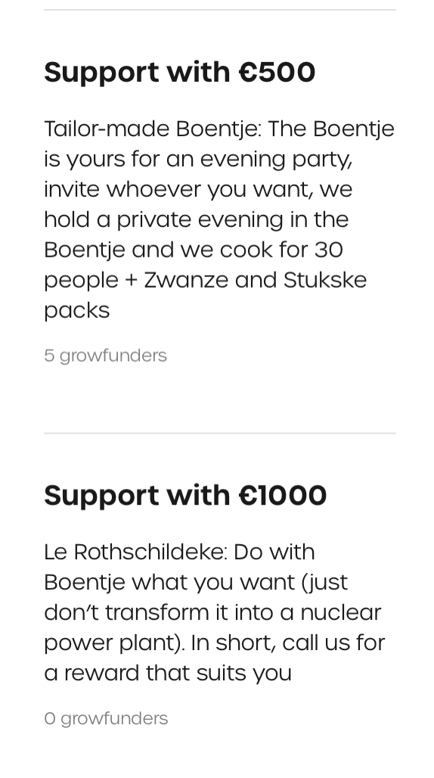
Multiple Rewards
The Boentje Café offered 7 types of rewards, starting from €10 to €1,000

