Slide 1
Value chain

Slide 2




9R Strategies in a Circular Economy
Circular economy
Smarter product use and manufacturing
R0 Refuse
Make a product redundant: abandon function or use different product
R1 Rethink
Make product use more intensive: sharing or multifunctional products
R2 Reduce
Consume less through efficient manufacturing or use
Extent lifespan of products and its parts
R3 Re-use
Re-use of functioning discarded products by another use
R4 Repair
Repair and maintenance of defects to keep original function
R5 Refurbish
Restore and update
R6 Remanufacture
Use part in new product with the same function
R7 Repurpose
Use products or parts in new product with a different function
Useful application of materials
R8 Recycle
Process materials to obtain the same (high grade) or lower (low grade) quality
Linear economy
R9 Recover
Incineration of materials with energy recovery

Slide 3
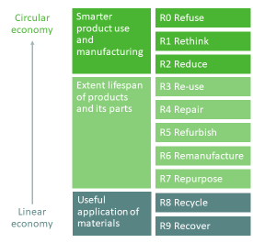










From Linear to Circular
Product design
Sourcing
Manufacturing
Logistics
Marketing & Sales
Product usage
End of life / disposal
R2 Reduce
R9 Recover
R2 Reduce
R5 Refurbish
R0 Refuse
R1 Rethink
R4 Repair
R3 Re-use
R6 Remanufacture
R7 Repurpose
R8 Recycle

Slide 4
Joint-Purchase

Slide 5
Joint Purchase generic model
01
02
03
04
05
06
07
NEEDS & IDEAS
PARTNERS
SPECIFICATIONS
TENDER SELECTION
PURCHASE
USAGE / END OF LIFE
EVALUATION
List the circular needs
Are the goods/services suitable for Joint Purchase?
Potential for collaboration with other firms is addressed
What type of collaboration is appropriate?
Potential partners are selected
Can we work together successfully?
If necessary, create a legal agreement
Specify the structure of the collaboration
Search for suitable suppliers of goods/services applying CE-principles
Create a product order
Produce a request for quotation (RFQ)
Review and compare suppliers offers
Finalize the purchase
Take delivery
Inspect goods
Make payment
Distribute goods
How does the joint-purchase strategy effect the product usage / end of life?
Product/service evaluation in use
Potential reuse at end of life?

Slide 6
Joint Purchase generic model
01
02
03
04
05
06
07
NEEDS & IDEAS
PARTNERS
SPECIFICATIONS
TENDER SELECTION
PURCHASE
USAGE &
END OF LIFE
EVALUATION

Slide 7
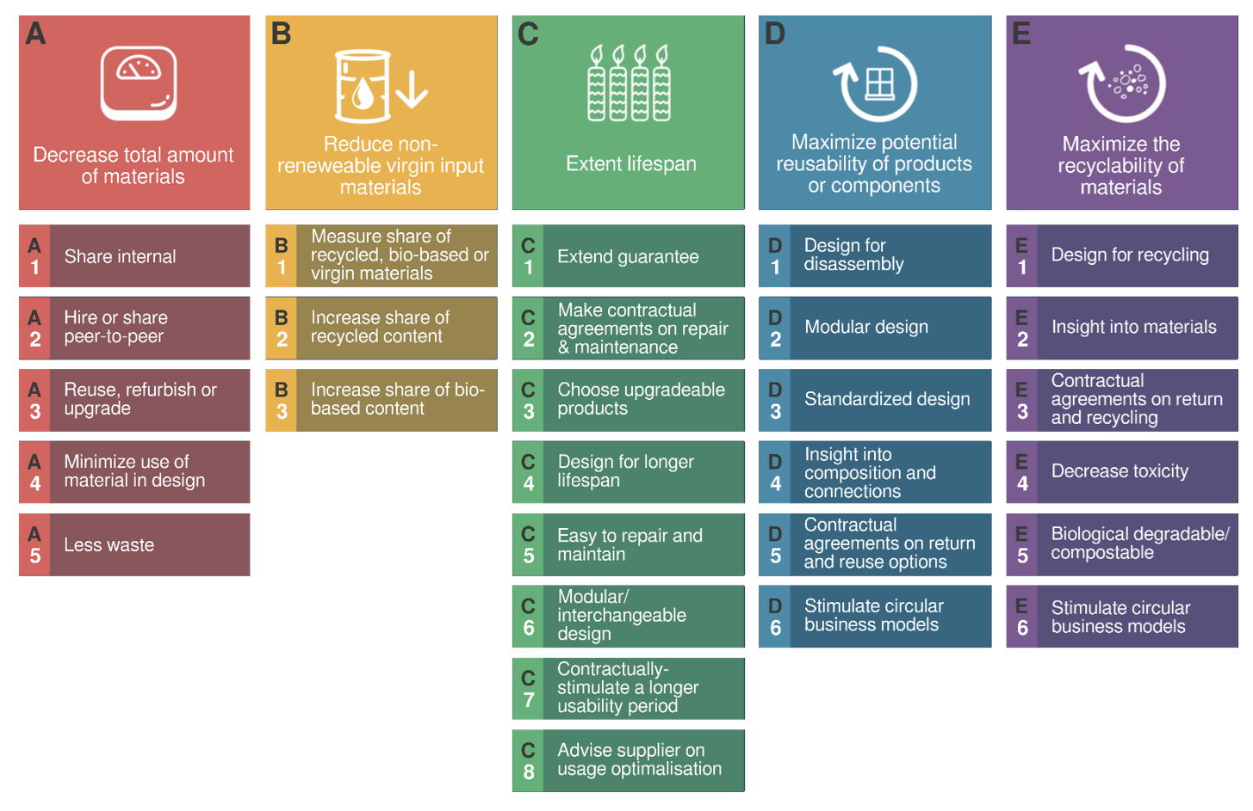
Reduce total amount of materials
Reduce non-renewable virgin input materials
Extend lifespan
Maximize potential reusability of components
Maximize the recyclability of materials
A
B
C
D
E
A
1
Share internal
B
1
Measure share of
recycled, bio-based or virgin materials
C
1
Extended guarantee
D
1
Design for disassembly
E
1
Design for recycling
A
2
Hire or share peer-to-peer
B
2
Increase share of recycled content
C
2
Make contractual agreements on repair and maintenance
D
2
Modular design
E
2
Insight into materials
A
3
Re-use, refurbish or upgrade
B
3
Increase share of bio-based content
C
3
Choose upgradeable products
D
3
Standardized design
E
3
Contractual agreements on return and recycling
A
4
Minimize use of material in design
C
4
Design for longer lifespan
D
4
Insight into composition and connections
E
4
Decrease toxicity
A
5
Less waste
C
5
Easy to repair and maintain
D
5
Contractual agreements on returns and reuse options
E
5
Biological degradable / compostable
C
6
Modular, interchangeable design
D
6
Stimulate circular business models
E
6
Stimulate circular business models
C
7
Contractually stimulate a longer usability period
C
8
Advice supplier on usage optimization

Slide 8
Relevant 9R-strategies for JP-project
REDUCE (R2) the total amount of materials
REFUSE (R0) / REDUCE (R2) non-
renewable raw materials (such as Crude Oil)
Circular Purchasing options based on circular needs
RETHINK (R1) Increase the lifespan of a
product
REUSE (R3) Choose a Product / parts of a
product that can be re-used at the end-of-life
RECYCLE (R8) The product can be recycled up
to a maximum level

Slide 9
Quadrupal Helix

Slide 10
Quadrupal Helix
Business & Industry
Education & Research
Tourism & leisure sector businesses, entrepreneurs, suppliers and technology providers
Academic and applied universities that offer education, training and scientific research
Local/regional government
Civil society/users
Different government levels, agencies for regional development, business advice, public procurement offices
NGO’s, citizen initiatives related to societal changes, consumer organizations,
different user groups

Slide 11
Government
Citizens
Academia
Industry

Slide 12
QUADRUPLE HELIX SUPPORT GROUPS
Quadruple Helix interconnects actors in Business, Government, Academia & Community. The aim is to understand the relationships and the value created between the different actors. Collaboration is key to transition to a resilient, circular economy. Within the FACET project, a platform of partners for each entrepreneur is to be established to support the entrepreneurs’ business transition from linear to circular. Please list partners within of the four domains listed below:
Business partners
Government partners
Support Group
Academia partners
Community partners

Slide 13
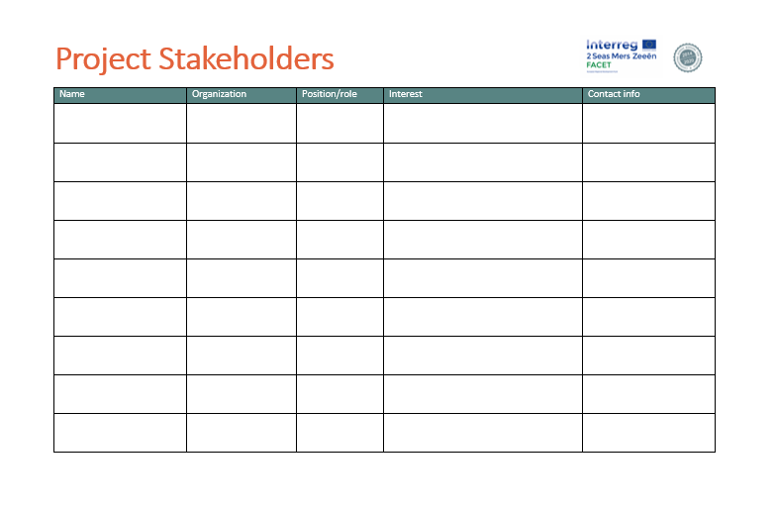

Project Stakeholders List

Slide 14
Stakeholder analysis
Meet their needs
Engage & consult
in interest area
Key player
Involve in governance/decision
making bodies
Engage & consult regularly
Influence/power of the stakeholder
Least important
to be informed via general communications - newsletter
Show consideration
Keep informed and consult on interest area
Interest of the stakeholder

