Slide 1
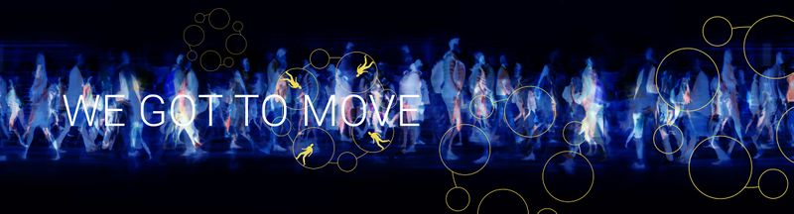
Social Innovation Principles
act together → learn together → act together → learn together → act together → learn together → act together → learn together → act together → learn together → act together → learn together → act together → learn together act together → learn together → …
HZ University of Applied Sciences / Solidarity University
wegottomove.org
April 2023

Slide 2
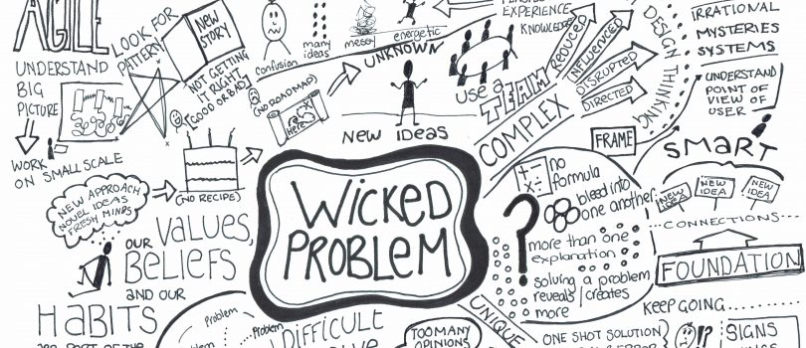

Slide 3
Wicked problems
The problem involves many stakeholders with different values and priorities.
The issue’s roots are complex and tangled.
The problem is difficult to come to grips with and changes with every attempt to address it.
The challenge has no precedent.
There’s nothing to indicate the right answer to the problem.
Nevertheless, in our experiences, it is possible to make progress by using the right insights and methods.

Slide 4
Sustainable Collaborative Learning Society
Societal challenge is central:
Making progress in wicked problems
Key question:
How can we utilize our expertise (knowledge and skills) in such a way that we can do the right things together?

Slide 5
Approach
Participative action research:
Not observing form the sidelines, but being part of the societal challenge to bring about change;
Systems thinking, synergy: 1 + 1 = 3;
Deeply entrenched in society: understanding culture and intentions.
A social innovation process should preferably yield a triple strike:
Making progress in a problematic situation in the sense that mutual understanding is obtained, and if possible, ways are found to take action;
Acquiring new skills by all involved, on how to facilitate change in processes with multiple stakeholders dealing with wicked problems;
Learning lessons about cultural identity from the experience gained in the implementation process.
A process for a process:
Develop a process (aimed at collaboration) to create a setting in which a social innovation process (aimed at the societal challenge) can flourish.

Slide 6
Principles and Ground rules
We can and should fall back on these principles and grund rules at all times (see www.wegottomove.org)
Principles:
Starting point: we moeten bewegen (we got to move)
Injunction: create room for change
Injunction: determine the right direction
Ground rules:
Co-dependency implies care responsibility
Diversity in opinions (worldviews) is a basic and essential right to make sustainable changes

Slide 7
Starting points We got to move
Social innovation:
A process
Making arguably desirable and culturally feasible progress in a societal challenge
Well founded in facts (e.g., scientific research)
Broadly acceptable
Sense of urgency:
Felt by all stakeholders
If not, make sure that the sense of urgency is recognized
Ground rule:
Co-dependency implies care responsibility

Slide 8
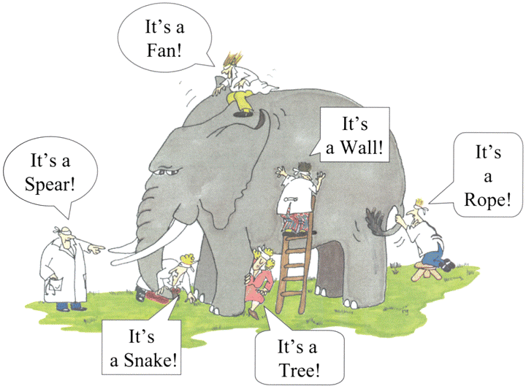
Injunction: create room for change Mutual understanding
Recognizing and acknowledging each other’s worldviews
Postponing judgements
In order to create room for change
Ground rule:
Diversity in opinions is a basic and essential right

Slide 9

Mutual influence
Interaction:
We act according to our worldviews (identity, ideas, assumptions, beliefs, etc.)
We try to fit feedback from others in our worldviews, sometimes resonance and sometimes rejection
Our worldviews are changed by means of interactions, most of the time gradually, and sometimes radically
Culture:
Our culture – who we are, and what we do - is shaped by mutual influence
This is our tradition, and it is subject to change – think of Saint Nicholas

Slide 10
Three dimensional identity model
Three dimensions (Heinich):
Example:
Self-perception: the relation with yourself, that is, who you are.
Presentation: how you present yourself to the outside world.
Attribution: how other people label and approach you.
In case of tension between those elements you become aware of your identity, which is felt as an identity conflict, or even worse, an identity crisis.
If you are part of a religious community, you are supposed to act the part of what is expected from you. But this may be in conflict with your self-perception, that is, who you really are, which might not tolerated in a particular religious tradition, such as homosexuality. Obviously, you then face a dilemma. You have to deal with the tension between your self-perception and your presentation if you want to remain part of the community you belong to.

Slide 11
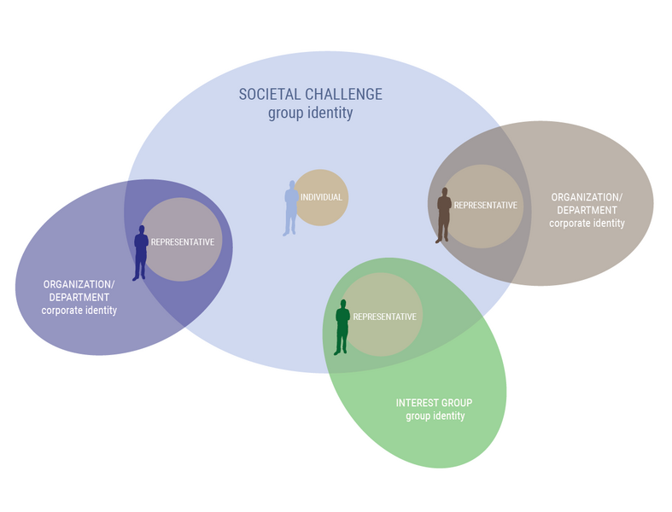
Responsible setting for social innovation
Issues:
Informal versus formal care responsibilities;
Mandated representants;
Prevention of identity and loyalty conflicts.

Slide 12
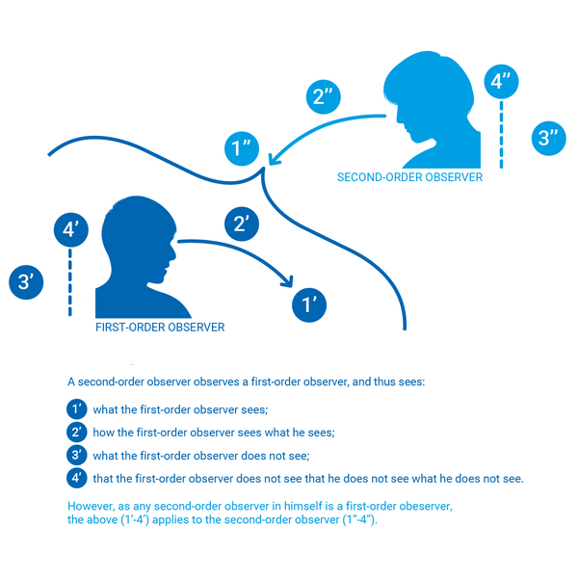
Guided conversation Looking at how someone looks

Slide 13
Guided conversation
Goal:
Getting insight in the worldview of a stakeholder;
Broadening the worldview of stakeholders. A guided conversation is already an intervention!
It is a two-way street, that is, a dialogue.
You are in control, you guide the conversation.
Form:
Before: compile a topic list;
During: really listen and dig deeper;
After: construct a worldview from what you have learned.

Slide 14
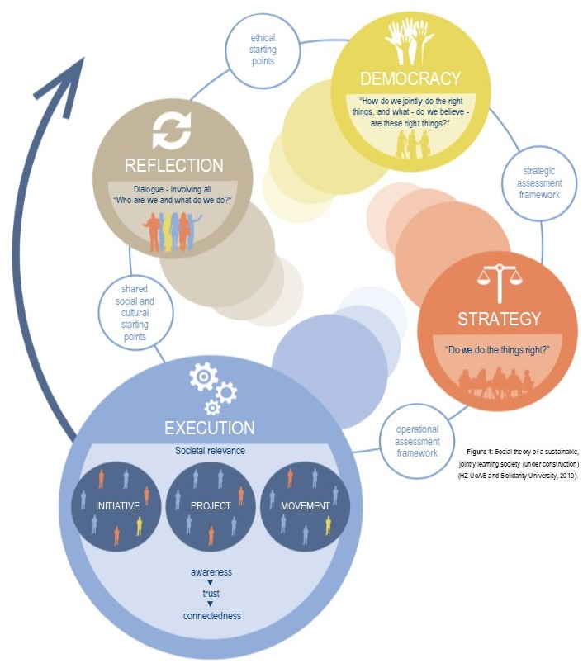
Injunction: determine the right direction Shared meaning
Steering on cultural identity: who we are, and what we do.
Verification (doing things right) → validation (doing the right things collectively). In the end: doing the right things right.
In order to find ways to change:
Arguably desirable and culturally feasible
Lasting impact but open to changing circumstances
Collectively learning from our experiences

