Slide 1


I-KNOW-HOW
Programme results: the roadmap, key perspectives and moments and some numbers
Isabel Weemaes
Arteveldehogeschool

Slide 2


Background of the project
Problem statement | Long-term illness continues to rise, both in numbers and duration. Employees (and employers) indicate that there are a lot of barriers in employing people during or after illness. Economically, socially and psychosocially there is a need to support people to be and stay at work during and after illness.
Countries | Belgium, The Netherlands, France, United Kingdom
Partners | Arteveldehogeschool, Sterpunt Inclusief Ondernemen – de Werkplekarchitecten, GTB, Centre Oscar Lambret, Métropole Européenne de Lille, Rother Voluntary Action, Sara Lee Trust, Hogeschool Zeeland, Planbureau en Bibliotheek van Zeeland
Funding and budget | 4 050 818,5 €
Timing | 01/02/2019 – 31/03/2023
1

Slide 3




Original idea:
1 toolbox for all countries
- Online interactive information tool
- Model for job coaching
- Coaching service for employers

Slide 4



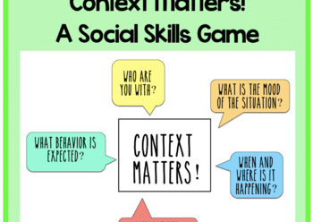
However…
(Labour) laws
Context
Partners
Culture
Need for tailored solutions/ different toolboxes

Slide 5
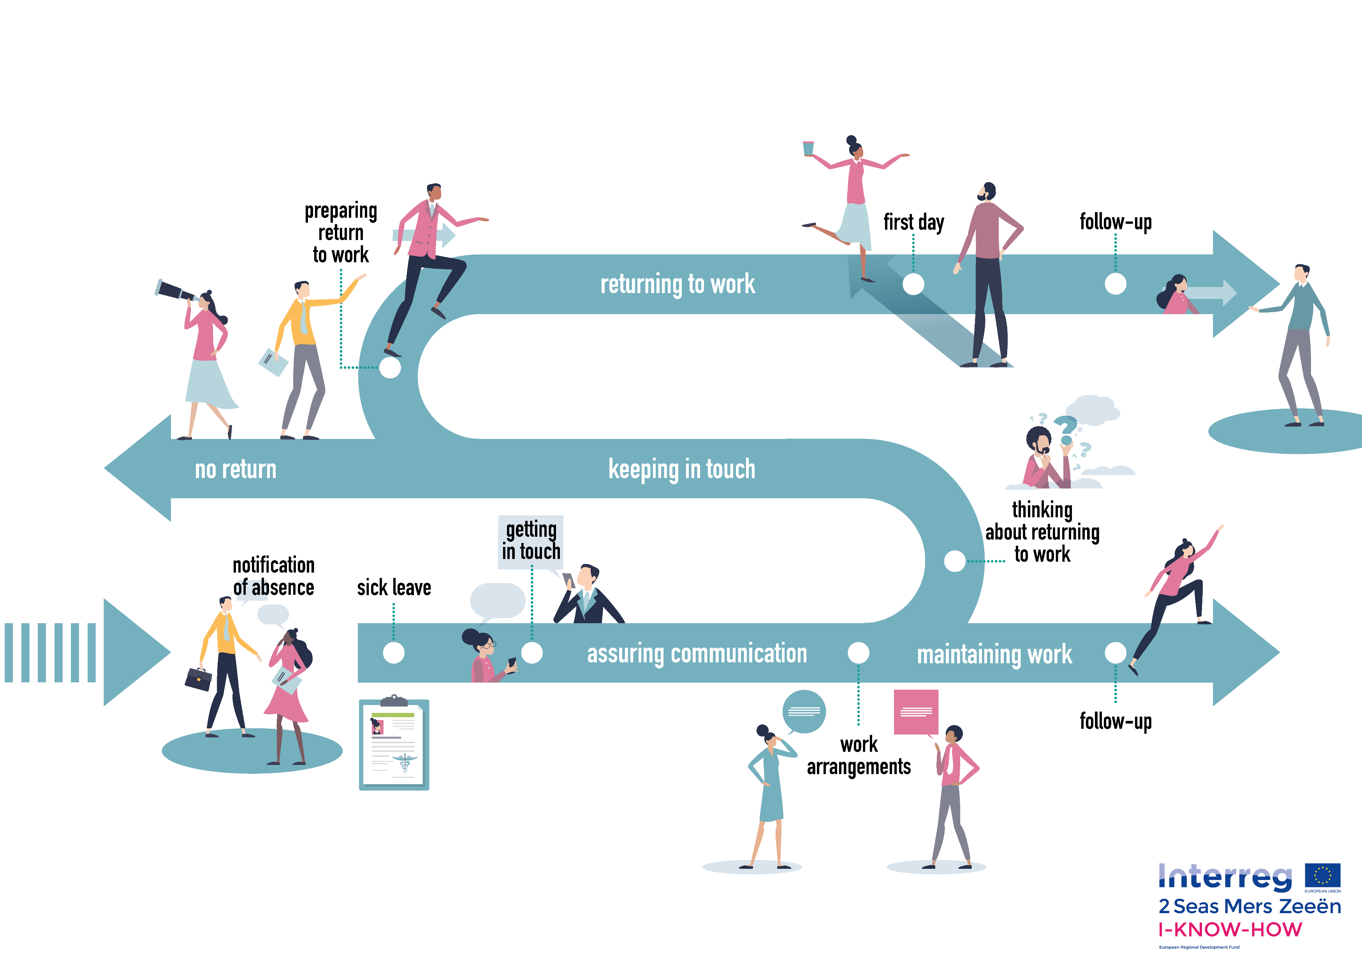
Looking for common ground… The Roadmap!

Slide 6


Key messages of the roadmap
Key moments!
Key perspectives: employer, employee, caregiver (formal/ informal)
Importance of early intervention
Colleagues and managers = network of the “patient”
Communication and contact between the 3 parties is imperative for succesfully remaining at or returning to work
  Intensity, content and quality of communication and contact can differ
      current situation
      respect!
      take care of...
      exchange of information on needs
      agreements
  … since not everyone is the same
  At the pace of the employee who is ill. No pressure or focus on return. Self management.
  Not a one-way street! Interest in other parties' needs and worries
6

Slide 7
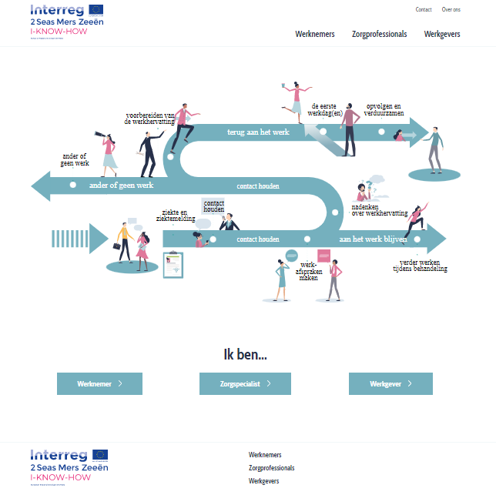

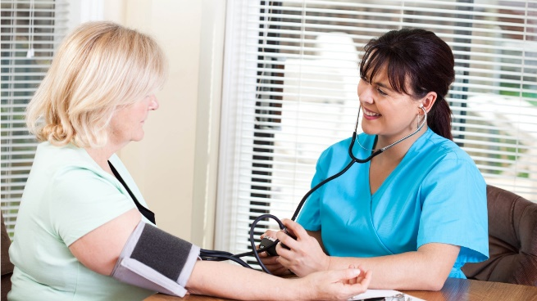

Translation principles roadmap into regional toolboxes - Belgium (Flanders)

Slide 8

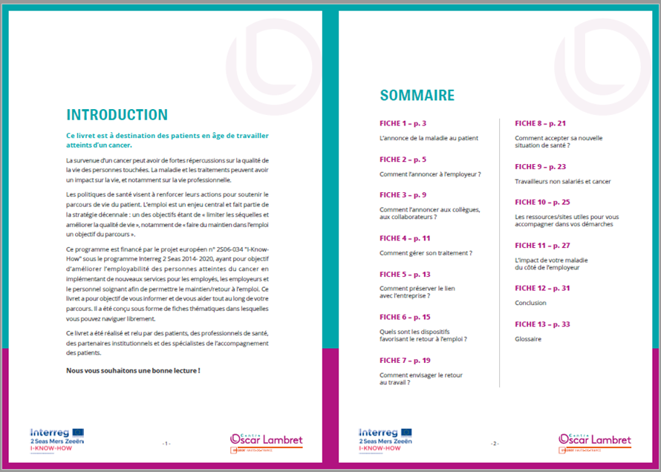
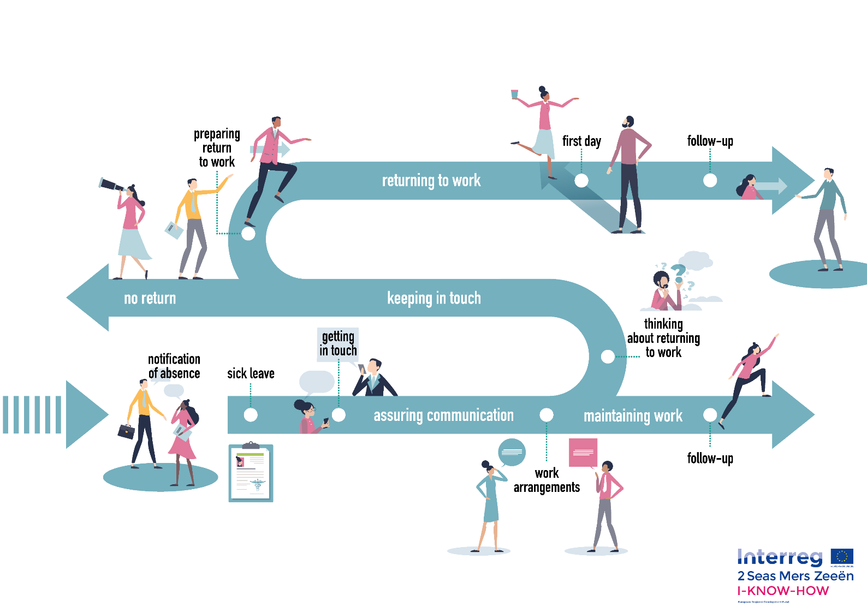


Translation principles roadmap into regional toolboxes - France

Slide 9
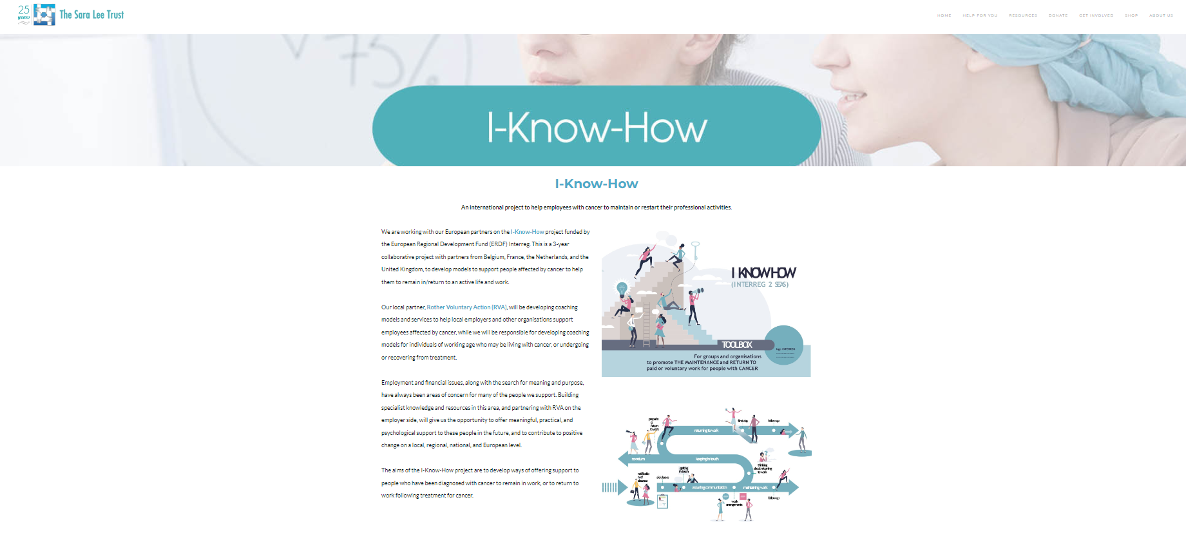


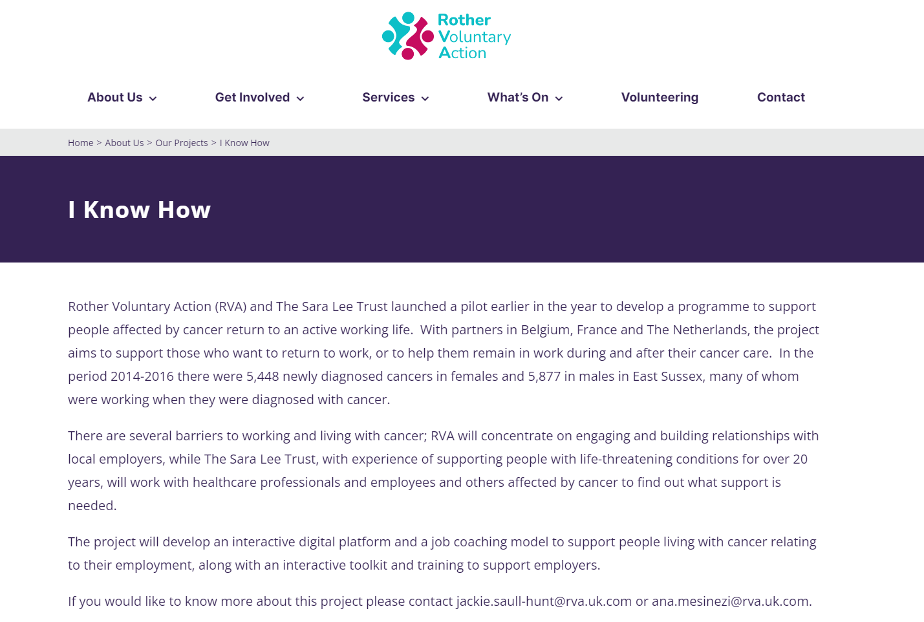
Translation principles roadmap into regional toolboxes - United Kingdom

Slide 10
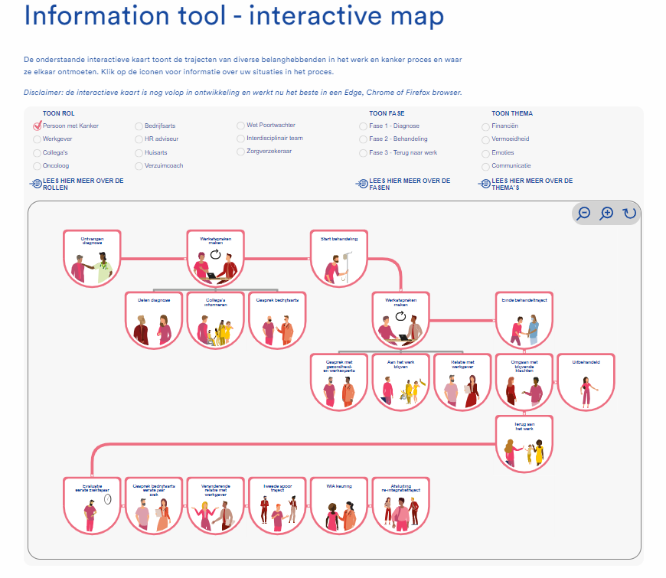

Translation principles roadmap into regional toolboxes - The Netherlands

Slide 11

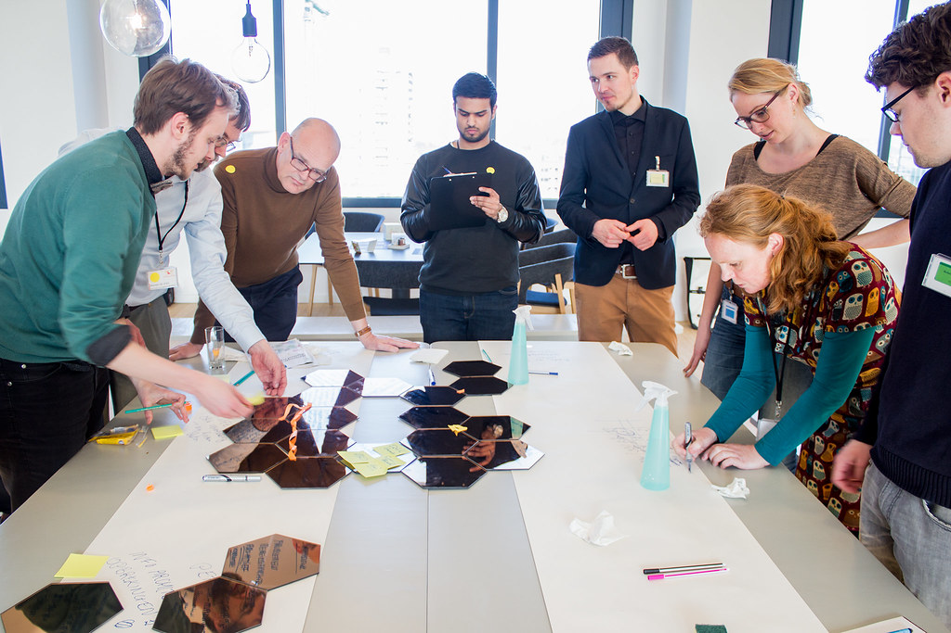
Implementation and structural embedding of the toolboxes?
Panel discussion and workshops in the afternoon!
11

Slide 12
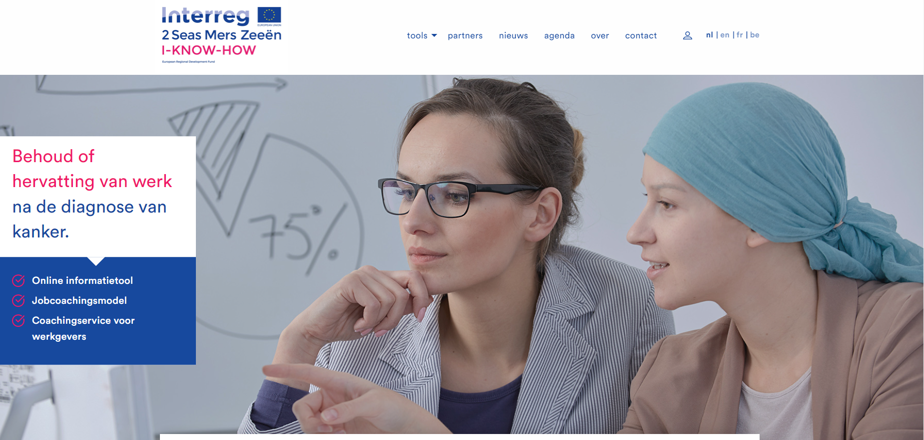

How to get to the regional toolboxes?
Contact details mentioned in Powerpoint presentations linked to the panel discussion!
International projectsite: I-KNOW-HOW 'working with cancer' – Projectenportfolio
  Choose language
  Choose “tools”
12

Slide 13

Up next?
What difference does it make? Impact and outcomes.
13

Slide 14
Thank you for your attention!

Slide 15

CONTACT
Project lead: Arteveldehogeschool (Gent-BE)
Ludo Moyersoen and
Isabel Weemaes
  ludo.moyersoen@arteveldehs.be
  isabel.weemaes@arteveldehs.be

